Slide 1
Thoracic Neuroendocrine Carcinomas: SCLC and LCNEC
Aman Chauhan, MD Associate Professor of Medicine Leader Neuroendocrine Oncology Program
Co-Leader Theranostics Program Sylvester Comprehensive Cancer Center
University of Miami

Slide 3
NET NEC
Well Differentiated
Poorly Differentiated
-Small Cell
-Large Cell
Grade 1
Grade 2
Grade 3
Grade 3

Slide 4
NET NEC
Well Differentiated
Poorly Differentiated
-Small Cell
-Large Cell
Grade 1
Grade 2
Grade 3
Grade 3

Slide 5
Histopathology: Small Cell/Poorly Differentiated

Slide 6
Lung Neuroendocrine Tumors and Carcinoma

Slide 7
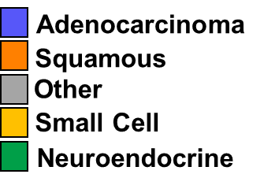
Lung Cancer : Histological Distribution
SEER database

Slide 8
Survival Rates
25% survival rate 1-year post diagnosis for SCLC
SEER data

Slide 9
Problems in Diagnosis of Lung NETs
Travis: 40 cases classified by 5 pathologists
Unanimous diagnosis 55% of the time
den Bakker: 170 cases of SCLC and LCNEC by 9 pathologists
Unanimous diagnosis 12%
Derks: 15% of > 3216 cases of lung NETs assigned a non-WHO diagnosis
Travis, WD et al Human Patholol 1998
den Bakker MA et al Histopathology 2010
Derks, JL et al, JTO 2016

Slide 10
Clinical Presentation (SCLC)
Rare to be diagnosed in early stage
Brain (30%)
Adrenal (20-40%)
Liver (25%)
Lung
Skeleton (35%)

Slide 11
SCLC Paraneoplastic Syndromes
SIADH (cisplatin, opiates can also cause hyponatremia)
Ectopic ACTH production- Cushing’s syndrome
Eaton-Lambert Myasthenic syndrome
proximal muscle weakness that improves on repetition (“facilitation”)
Hypercalcemia
Peripheral Neuropathy/encephalomyelitis (anti HU; order paraneoplastic panel)

Slide 12
Two most common neuroendocrine paraneoplastic syndromes

Slide 13
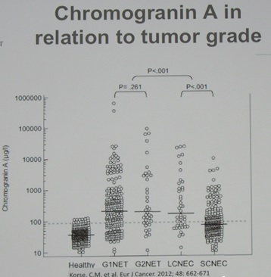
Blood Based Diagnostic Test Unreliable
Chromogranin A
NSE

Slide 14
LCNEC-NGS

Slide 17
SCLC Staging
NCCN recommends incorporation of both Old VA Classification and TNM classification
VA: Limited Stage
Confined to ipsilateral hemithorax and can be covered in a radiation field
Extensive Stage
Beyond ipsilateral hemithorax, distant mets, pleural effusion

Slide 18
Surgical Treatment for Stage I

Slide 19
Limited vs. Extensive stage
 | Limited stage | Extensive stage
Incidence | 1 out of 3 people with SCLC | 2 out of 3 people with SCLC
Spread | Only in one lung and perhaps in lymph nodes on the same side of the chest | To other lung, to lymph nodes on the other side of the chest, or to distant organs
Area | confined to an area | Wide spread
Treatment | chemo-radiation ± PCI | Chemotherapy/Immuno± PCI
Notes:
Due to the high rate of early metastases, chemotherapy is an integral part of treatment for all stages of SCLC

Slide 20
First Line Therapy
During the 1970s CAV (cyclophosphamide, adriamycin, and vincristine) was the standard regimen
In the 1980s several phase III clinical trials demonstrated that EP (Etoposide + Platinum) was equivalent to CAV

Slide 21
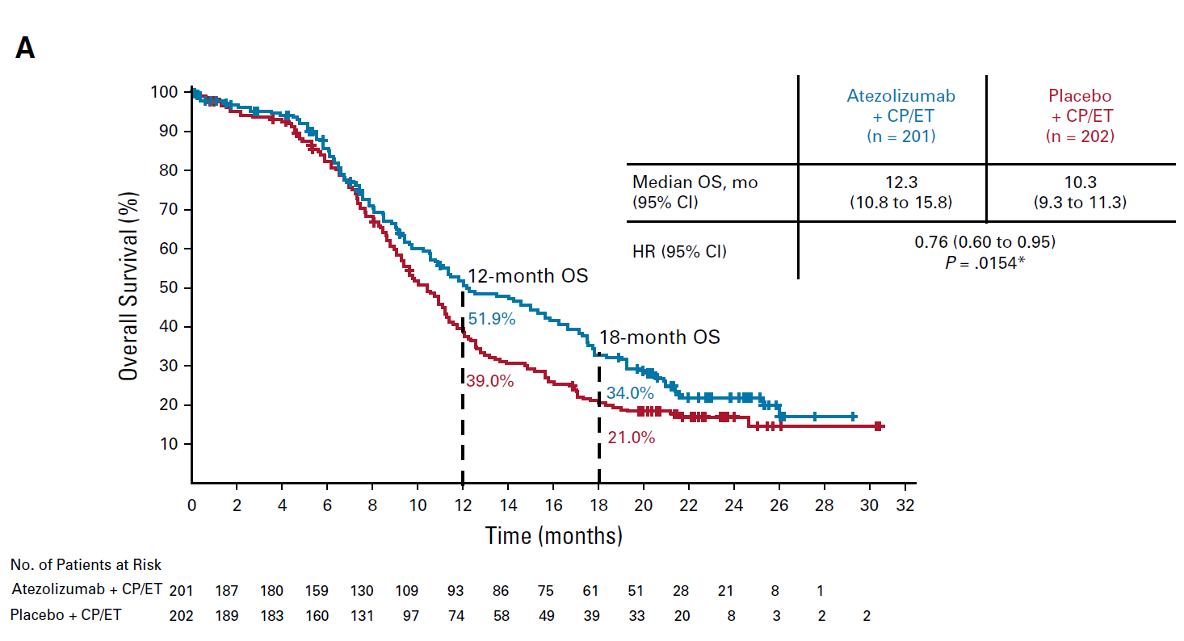
Immunotherapy 1st line advanced SCLC Impower 133 Carbo+Etop +/- Atezo then Atezo maintenance: Overall Survival (Median F/U 22.9 mos)
Given much censorship of data past 18 mos, implications for long term survival with added atezo are pending.
Since there are 5 year OS advantages for NSCLC with added immune checkpoint inhibitors, and the great importance of this outcome, this is a key question.
Hazard Ratio 0.79
Liu. JCO 2021; 39:619-630

Slide 22
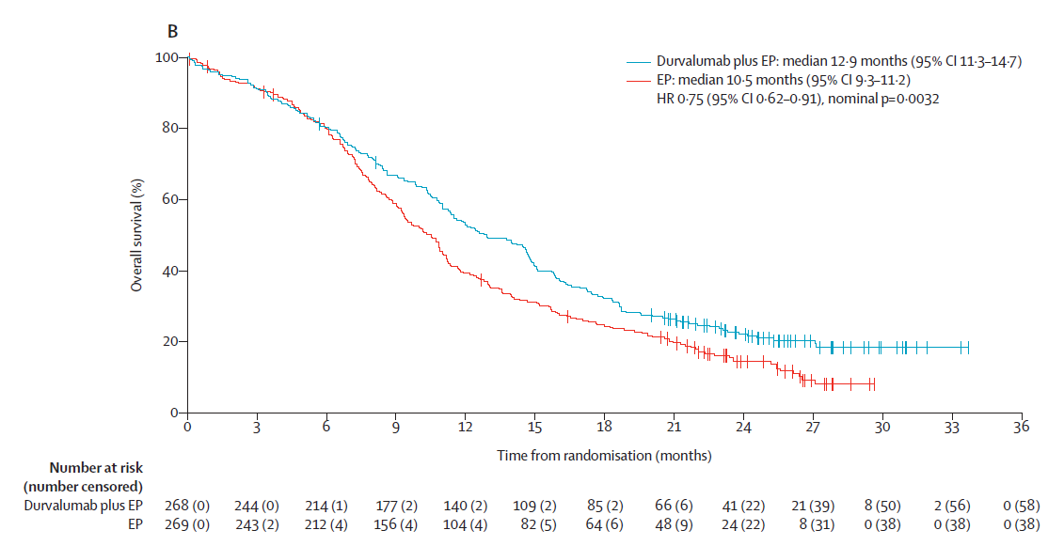
Immunotherapy 1st line advanced SCLC CASPIAN: Platinum+Etop +/- Durva then maintenance Durva: OS (Median F/U 25.1 mos)
Given much censorship of data past 20 mos, implications for long term survival with added Durva are pending.
Since there are 5 year OS advantages for NSCLC with added immune checkpoint inhibitors, and the great importance of this outcome, this is a key question.
Hazard Ratio 0.75
Chemo + Durva
Chemo
Goldman , Lancet Oncol,2021

Slide 23
Second Line Therapy
Although SCLC is very responsive to initial treatment, most patients relapse with relatively resistant disease
These patients have a median survival of only 4 to 5 months when treated with further chemotherapy
Second line and third line chemotherapy provides significant palliation in many patients, although the likelihood of response is highly dependent on the time from initial therapy to relapse
If the interval is less than 3 months, response to most agents is poor (<10%)
If interval is more than 3 months, then the expected response rates are approximately 25%
If patients relapse more than 6 months after first line treatment, then treatment with their original regimen is recommended

Slide 24
Lurbinectadine
DNA Binding agent, selectively inhibits RNA polymerase II transcription
Single Arm Phase II: 35.2% ORR, mPFS 3.5 mo, mOS 9.3 mo
Grade 4 neutropenia 25%
Grade 4 thrombocytopenia 4%
Serious AE 10% (febrile neutropenia etc)

Slide 25
Subsequent Therapy

Slide 26
Clinical Trials: Shaping the Future through Evidence-Based Innovation

Slide 27
Breaking NEWS
The First and Only FDA Approved DLL-3 targeting BiTE for ES SCLC

Slide 28
Tarlatamab in SCLC

Slide 31
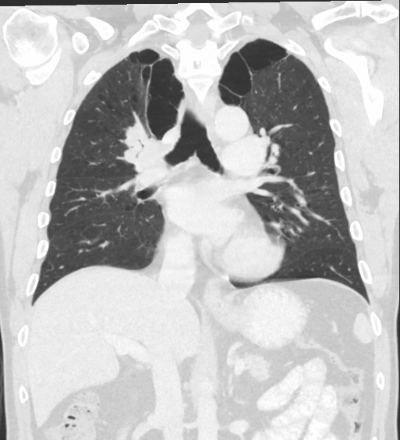
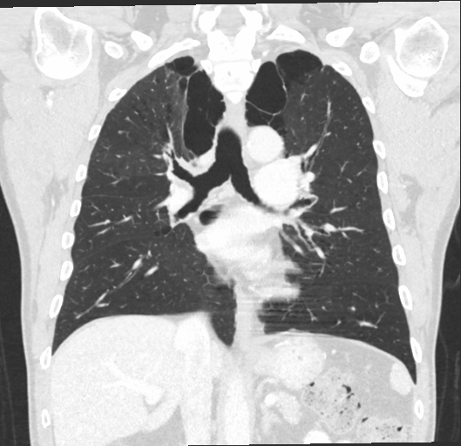
Two Years Apart

Slide 32
What is DLL-3 BiTE and What about non SCLC NEC patients?

Slide 33
Heterodimeric IgG-like scaffold (half-life extended)
Based on Boehringer’s proprietary platform
Engineered Fc to minimize effector functions

Slide 34
Ref:
Hermans BCM, et al. Lung Cancer 2019;138:102–108;
Lima CF, et al. Abstract 5305 at AACR; Apr8–13, 2022; New Orleans

Slide 35
Other DLL3-targeting TcEs under investigation, with varying molecular structures, target indications and stages of development
*AMG-757 is also under investigation for prostate NEC (Phase I) and ll SCLC (not yet recruiting for Phase 111).5BiTE, bispecific T-cell engager; CD3, cluster of differentiation 3; DLL3, delta-like protein 3; Fe, fragment crystallizable; HLE, half-life extended; lgG, human immunoglobulin G; L, line;NEC/NEN, neuroendocrine carcinoma/neoplasm; SCLC, small cell lung cancer; TBC, to be confirmed; TcE, T-cell engager; TriTAC, Tri-specific T cell-activating construct. l. IMDELLTRA™ (tarlatamab) prescribing information; 2. Giffin MJ et al. Clin Cancer Res 2021;27:1526-1537; 3. Merck Press Release: Merck Completes Acquisition of Harpoon Therapeutics, Inc. (Mar 2024; accessed Apr 2024); 4. Voynov Vet al. Antibodies 2020;9:65; 5. Clinicaltrials.gov (accessed Apr 2024).

Slide 36
First-in-human dose escalation trial of obrixtamig in patients with SCLC or NECs: NCT04429087
Regimen A
Regimen B
Dose A (n)
Regimen B1
Regimen B2
Dose A5
Dose A4
Dose B1.n
Dose B2.n
BLRM
BLRM
BLRM
Dose B2.3
Dose A3
Dose B1.3
Dose A2
Dose B1.2
Dose B2.2
Dose B1.1
Dose B2.1
Dose A1
Switch to B1 based on regimen A data
Switch to step-in dosing (B2) based on regimen A and B1 data
IV dose q3 weeks
IV dose once every week
Primary endpoints
MTD DLTs in the MTD evaluation period
Primary endpoints
MTD DLTs in the MTD evaluation period
Patients are treated until disease worsening or a maximum duration of 36 months
BLRM, Bayesian Logistic Regression Model with overdose control; DLTs, dose-limiting toxicities; IV, intravenous; MTD, maximum tolerated dose; PK, pharmacokinetic; RECIST, Response Evaluation Criteria In Solid Tumors version 1.1

Slide 37
Inclusion criteria and patient baseline characteristics
As of March 2023† | N=107‡
Median age, years (range) | 60.0 (32–79)
Male, n (%) | 61 (57)
Prior lines of therapy, n (%)
1–2 | 72 (67)
≥3 | 33 (31)
ECOG PS 0/1, n (%) | 28 (26)/78 (73)
Prior PD-1/PD-L1, n (%) | 52 (49)
Brain/liver metastases, n (%) | 41 (38)/60 (56)
Advanced SCLC, LCNEC, or epNEC
DLL3 positive (archived tissue or in-study biopsy) according to central* review
Failed/ineligible for available standard therapies (≥1 line of platinum-based chemotherapy)
Adequate liver, bone marrow and renal function
n=57
53%
SCLC
n=41
38%
epNEC
(extrapulmonary origin)
n=9
8%
LCNEC
ECOG PS 0/1
*Ventana DLL3 (SP347) assay at the
Roche CDx CAP/CLIA laboratory
*†Data snapshot:
26th March 2023
‡Safety population:
≥1 dose of BI 764532
CAP/CLIA, College of American Pathologists & Clinical Laboratory Improvement Amendment; ECOG PS, Eastern Cooperative Oncology Group performance status; epNEC, extrapulmonary neuroendocrine carcinoma; LCNEC, large cell neuroendocrine lung carcinoma; PD-1, programmed cell death protein -1; PD-L1, programmed death-ligand 1; SCLC, small cell lung cancer

Slide 38
Most common treatment-related AEs (>10% patients)
TRAE, n (%) | Total (N=107; 100%)*
TRAE*, n (%) | All grade | Grade 1–2 | Grade 3–5
Number of pts with ≥1 TRAE | 92 (86) | 63 (59) | 29 (27)
CRS | 63 (59) | 61 (57) | 2 (2)
Lymphocyte count decreased | 21 (20) | 4 (4) | 17 (16)
Dysgeusia | 21 (20) | 21 (20) | 0
Asthenia | 20 (19) | 19 (18) | 1 (<1)
Pyrexia | 19 (18) | 19 (18) | 0
AST increased | 15 (14) | 13 (12) | 2 (2)
Fatigue | 15 (14) | 14 (13) | 1 (<1)
Nausea | 13 (12) | 13 (12) | 0
Patients with AEs/TRAEs leading to discontinuation: 13%/4%
CRS managed with supportive care, corticosteroids, and/or anti-IL-6R antibodies
*Safety population:
≥1 dose of BI 764532
AST, aspartate aminotransferase; CRS, cytokine release syndrome; IL-6R, interleukin 6 receptor; TRAEs, treatment-related AEs

Slide 39
DLTs, TRAEs and AE in patients with epNEC (≥5 patients)
CRS was the most common TRAE and was managed with supportive care, corticosteroids, and/or anti-IL-6R antibodies
MTD not reached; dose escalation ongoing
Overall, six patients had DLTs; two epNEC patients had DLTs (grade 3 CRS and grade 5 ICANS*)
One grade 5 TRAE: ICANS in a patient with epNEC
TRAEs, n (%) | Patients with epNEC (n=54)†
TRAE*, n (%) | Any grade | Grade ≥3
Any TRAE | 51 (94) | 10 (19)
CRS | 39 (72) | 2 (4)
Pyrexia | 16 (30) | 0
Dysgeusia | 10 (19) | 0
Fatigue | 9 (17) | 0
Asthenia | 8 (15) | 0
Decreased appetite | 7 (13) | 0
Lymphocytes decreased | 7 (13) | 6 (11)
Nausea | 6 (11) | 0
AST increased | 5 (9) | 1 (2)
Vomiting | 5 (9) | 0
†Safety population: ≥1 dose of BI 764532 as of 14 Aug 2023
*Grade 5 ICANS was classified as a DLT after database lock
AE, adverse event; AST, aspartate aminotransferase; CRS, cytokine release syndrome; DLT, dose-limiting toxicity; IL-6R, interleukin 6 receptor; ICANS, immune effector cell-associated neurotoxicity syndrome; MTD, maximum tolerated dose; TRAE, treatment-related AE.

Slide 40
Overall Efficacy
n, (%) | All dose levels (n=99; 100%)* | <90 µg/kg (n=28; 100%) | ≥90 µg/kg (n=71; 100%)
PR | 18 (18) | 0 | 18 (25)
SD | 23 (23) | 4 (14) | 19 (27)
PD | 45 (45) | 20 (71) | 25 (35)
DCR | 41 (41) | 4 (14) | 37 (52)
NE† | 13 (13) | 4 (14) | 9 (13)
150
Dose level, µg/kg
120
<90
PD
≥90
90
PD
PD
PD
Ongoing
60
PD
PD
PD
PD
PD
PD
PD
PD
PD
30
PD
PD
PD
PD
PD
PD
Best change from baseline in SOD (%)
PD
PD
PD
PD
PD
PD
PD
PD
PD
PD
PD
PD
20
PD
PD
SD
SD
PD
PD
0
PD
SD
SD
PD
SD
PD
SD
PD
SD
SD
SD
SD
PD
PD
SD
SD
SD
SD
SDO
PD
-30
PD
SD
SD
SD
SD
-30
SD
PD
SD
SD
SD
PR
PR
PR
PR
PR
-60
PR
PR
PR
PR
PR
PR
PR
PR
PR
PR
PR
-90
PR
Efficacy, i.e. tumor shrinkage, observed at doses ≥90 µg/kg
PR
-120
*Efficacy population: ≥1 post-baseline tumor assessment or permanently discontinued prior to tumor assessment; responses evaluated per RECIST v1.1 criteria; †Discontinued prior to tumor assessment
DCR, disease control rate; NE, not evaluable; PD, progressive disease; PR, partial response; RECIST, Response Evaluation Criteria in Solid Tumors; SD, stable disease; SOD, sum of diameters

Slide 41
Efficacy by tumor type (doses ≥ 90µg/kg)
n, (%) | SCLC (n=39; 100%)*
PR | 10 (26)
SD | 10 (26)
PD | 12 (31)
DCR | 20 (51)
NE† | 7 (18)
SCLC
100
PD
PD
50
PD
PD
PD
Best change from baseline in SOD (%)
PD
PD
SD
PD
PD
SD
SD
0
PD
SD
SD
SD
PD
SD
SD
SD
PD
SD
PR
-50
PR
PR
PR
PR
PR
PR
PR
PR
Ongoing
PR
-100
*Efficacy population: ≥1 post-baseline tumor assessment or permanently discontinued prior to tumor assessment; responses evaluated per RECIST v1.1 criteria; †Discontinued prior to tumor assessment
DCR, disease control rate; NE, not evaluable; ep NEC, extrapulmonary neuroendocrine carcinoma; PD, progressive disease; PR, partial response; SCLC, small-cell lung cancer; SD, stable disease; SOD, sum of diameters

Slide 42
Efficacy by tumor type (doses ≥ 90µg/kg)
n, (%) | SCLC (n=39; 100%)* | epNEC (n=27; 100%)*
PR | 10 (26) | 5 (19)
SD | 10 (26) | 7 (26)
PD | 12 (31) | 13 (48)
DCR | 20 (51) | 12 (44)
NE† | 7 (18) | 2 (7)
SCLC
epNEC
PD
100
PD
PD
PD
50
PD
PD
PD
PD
PD
PD
PD
PD
PD
PD
PD
Best change from baseline in SOD (%)
PD
PD
SD
PD
0
PD
SD
SD
PD
SD
SD
PD
SD
PD
SD
SD
PD
SD
SD
PD
SD
SD
SD
SD
PD
SD
PR
SD
SD
-50
PR
PR
PR
PR
PR
PR
PR
PR
PR
PR
PR
PR
PR
PR
-100
Ongoing
*Efficacy population: ≥1 post-baseline tumor assessment or permanently discontinued prior to tumor assessment; responses evaluated per RECIST v1.1 criteria; †Discontinued prior to tumor assessment
DCR, disease control rate; NE, not evaluable; ep NEC, extrapulmonary neuroendocrine carcinoma; PD, progressive disease; PR, partial response; SCLC, small-cell lung cancer; SD, stable disease; SOD, sum of diameters

Slide 43
Efficacy by tumor type (doses ≥ 90µg/kg)
n, (%) | SCLC (n=39; 100%)* | epNEC (n=27; 100%)* | LCNEC (n=5; 100%)*
PR | 10 (26) | 5 (19) | 3 (60)
SD | 10 (26) | 7 (26) | 2 (40)
PD | 12 (31) | 13 (48) | 0
DCR | 20 (51) | 12 (44) | 5 (100)
NE† | 7 (18) | 2 (7) | 0
SCLC
epNEC
LCNEC
PD
100
PD
PD
PD
50
PD
PD
PD
PD
PD
PD
PD
PD
PD
PD
PD
Best change from baseline in SOD (%)
PD
20
PD
SD
PD
SD
PD
SD
SD
PD
SD
PD
SD
0
SD
SD
SD
PD
SD
SD
SD
PD
SD
SD
PD
Efficacy i.e. tumor shrinkage was observed across all enrolled tumor types
SD
PD
SD
SD
SD
SD
-30
PR
PR
PR
PR
PR
-50
PR
PR
PR
PR
PR
PR
PR
PR
PR
PR
PR
PR
Ongoing
*Efficacy population: ≥1 post-baseline tumor assessment or permanently discontinued prior to tumor assessment; responses evaluated per RECIST v1.1 criteria; †Discontinued prior to tumor assessment
DCR, disease control rate; NE, not evaluable; ep NEC, extrapulmonary neuroendocrine carcinoma; PD, progressive disease; PR, partial response; SCLC, small-cell lung cancer; SD, stable disease; SOD, sum of diameters

Slide 44
Response duration (all indications)
Current duration of objective response*
(as of 21 April 2023)
13.1
6.7
10.7
Responses are ongoing in 14/18 responders
Median duration of response has not been reached
Responses appear to be durable
9.4
2.8
4.7
4.0
4.0
4.0
4.6
4.0
Tumor response and status
3.1
Response ongoing
4.2
Partial response
1.4
1.2
Stable disease
<1
Disease progression
1.2
<1
0
1
2
3
4
5
6
7
8
9
10
11
12
13
14
15
Treatment duration (months)
*Duration of objective response (DoR) is defined as the time from first documented complete response (CR) or partial response (PR) until the earliest of disease progression or death among patients with objective response according to RECIST 1.1 .

Slide 45
LCNEC-L case study: current DoR of 22.1 months and ongoing

Slide 46
HPN328-4001 (DLL-3 BiTE) Phase 1 Study; Harpoon Therapeutics
Noura Choudhury | Impact of brain metastases on safety and efficacy of MK-6070 in SCLC; WCLC 2024

Slide 47
Future Directions for DLL-3 Targeting
Radioligand targeting of DLL-3
CAR-T targeting of DLL-3
DLL-3 BiTE Targeting
Frontline with chemotherapy
Second line with chemotherapy

Slide 48
Any other exciting drugs?

Slide 51
A total of 42 patients were consented and 33 met eligibility criteria and were treated.
All patients received 4-6 cycles of frontline platinum doublet and had at least a partial response by RECIST at the time of enrollment.
The median PFS (mPFS) was 3 months from time of enrollment on frontline maintenance (post platinum doublet).
The mPFS was 11 months from cycle 1 of platinum doublet.
Overall, 89.8% patients were alive at 12 months and 54.4 % patients were alive at 24 months from the start of platinum doublet.
Chauhan A. AACR 2023

Slide 54
NEC and Radioligand Therapy (RLT)

Slide 55
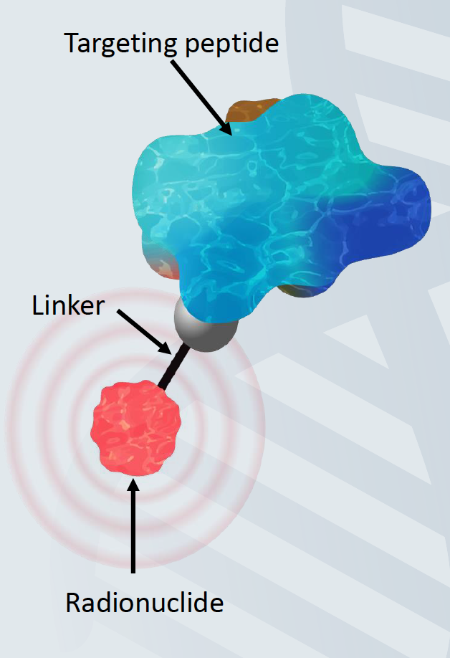
Theranostic
Small amount of radioactive material linked to a cell-targeting agent for the diagnosis and treatment of cancer¹
Gallium 68 dotatate, a radiolabeled somatostatin analog approved to evaluate SSTR status
Lutetium 177 dotatate, a radiolabeled somatostatin analog approved for the treatment of midgut carcinoid tumors²
177Lu-PSMA-617, a radiolabeled prostate-specific membrane antigen-binding (PSMA) dipeptide for mCRPC³
Grzmil M et al. An Overview of Targeted Radiotherapy. In: J. S. Lewis, A. D. Windhorst and B. M. ZeglisRadiopharmaceutical Chemistry. Springer International Publishing, Cham. 2019:pp85–100;2. LutatheraPrescribing Information. July 2018.Advanced Accelerator Applications, Inc.;3. ClinicalTrials.gov. https://clinicaltrials.gov. Accessed May 3, 2020

Slide 56
SSTR expression in solid tumors

Slide 57
RESULTS (N=97):
64% of SCLC samples stained positive for SSTR-2
35.7% of SCLC samples stained strongly positive (3+)
33% of poorly differentiated neuroendocrine carcinoma samples stained positive, of which only 11% stained strongly positive

Slide 58
SSTR PET pre and post PRRT

Slide 59
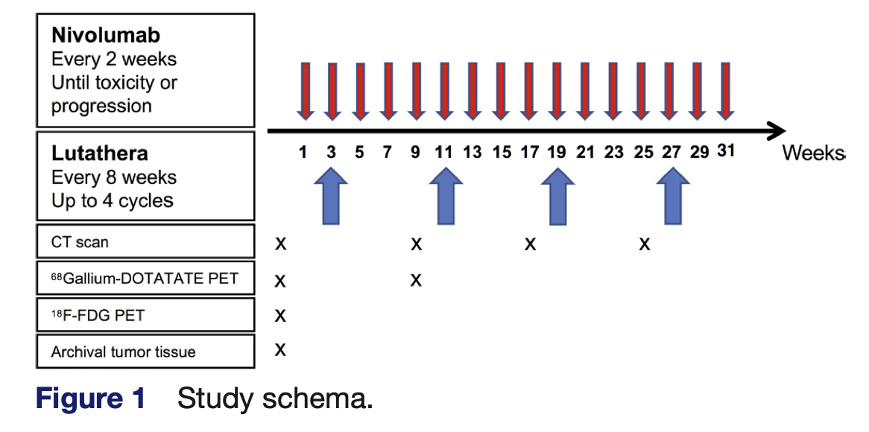
SSTR in SCLC
Nine patients were enrolled (six ES-SCLC, two pulmonary atypical carcinoid, one high-grade pulmonary neuroendocrine carcinoma).
Lutathera plus nivolumab was well tolerated and showed signs of antitumor activity.

Slide 60
Stay Tuned for Clinical trials for NEC targeting SSTR!!

Slide 61
Radioligand Therapy (RLT) beyond SSTR targeting in SCLC

Slide 62
DLL a potential target?

Slide 63
DLL3-targeting by radioimmunoconjugates
MSKCC group presented pre-clinical data on two leading candidates (mAb1 and mAb2) for imaging and therapy in preclinical SCLC models.
Zirconium-89 (⁸⁹Zr) was used for imaging and Lutetium-177 (¹⁷⁷Lu) for therapy.

Slide 64
Summary
Most SCLC and NEC pts present with metastatic disease.
1st line chemo (+ ICI for SCLC)
High response rate 50-70%
But, most recur within the first year.
Some improvement with introduction of immunotherapy but still a long way to go.
Outcomes with 2nd-line treatment are poor but options do exists.
DLL-3 BiTE seems to be a promising therapy
PARP-IO and VEGF-IO needs to be investigated further
Radioligand Therapy (RLT) can be complimentary to current treatments as SCLC are extremely radiosensitive

Slide 65
Oncolytic Virus + Immune Checkpoint Inhibitors

Slide 66
First in Human Phase 1 Study
Oncolytic Virus +
Ipi + Nivo
PI: Aman Chauhan
(Sylvester Comprehensive Cancer Center)

Slide 67
Thank You
@AmanChauhanMD

