Slide 1
Thoracic Neuroendocrine Neoplasms
Aman Chauhan, MD
Associate Professor of Medicine
Leader Neuroendocrine Oncology Program
Co-Leader Theranostics Program
Sylvester Comprehensive Cancer Center
University of Miami

Slide 2
Learning Objectives
Review subsets of thoracic neuroendocrine neoplasms
Novel therapy options for thoracic NENs

Slide 3
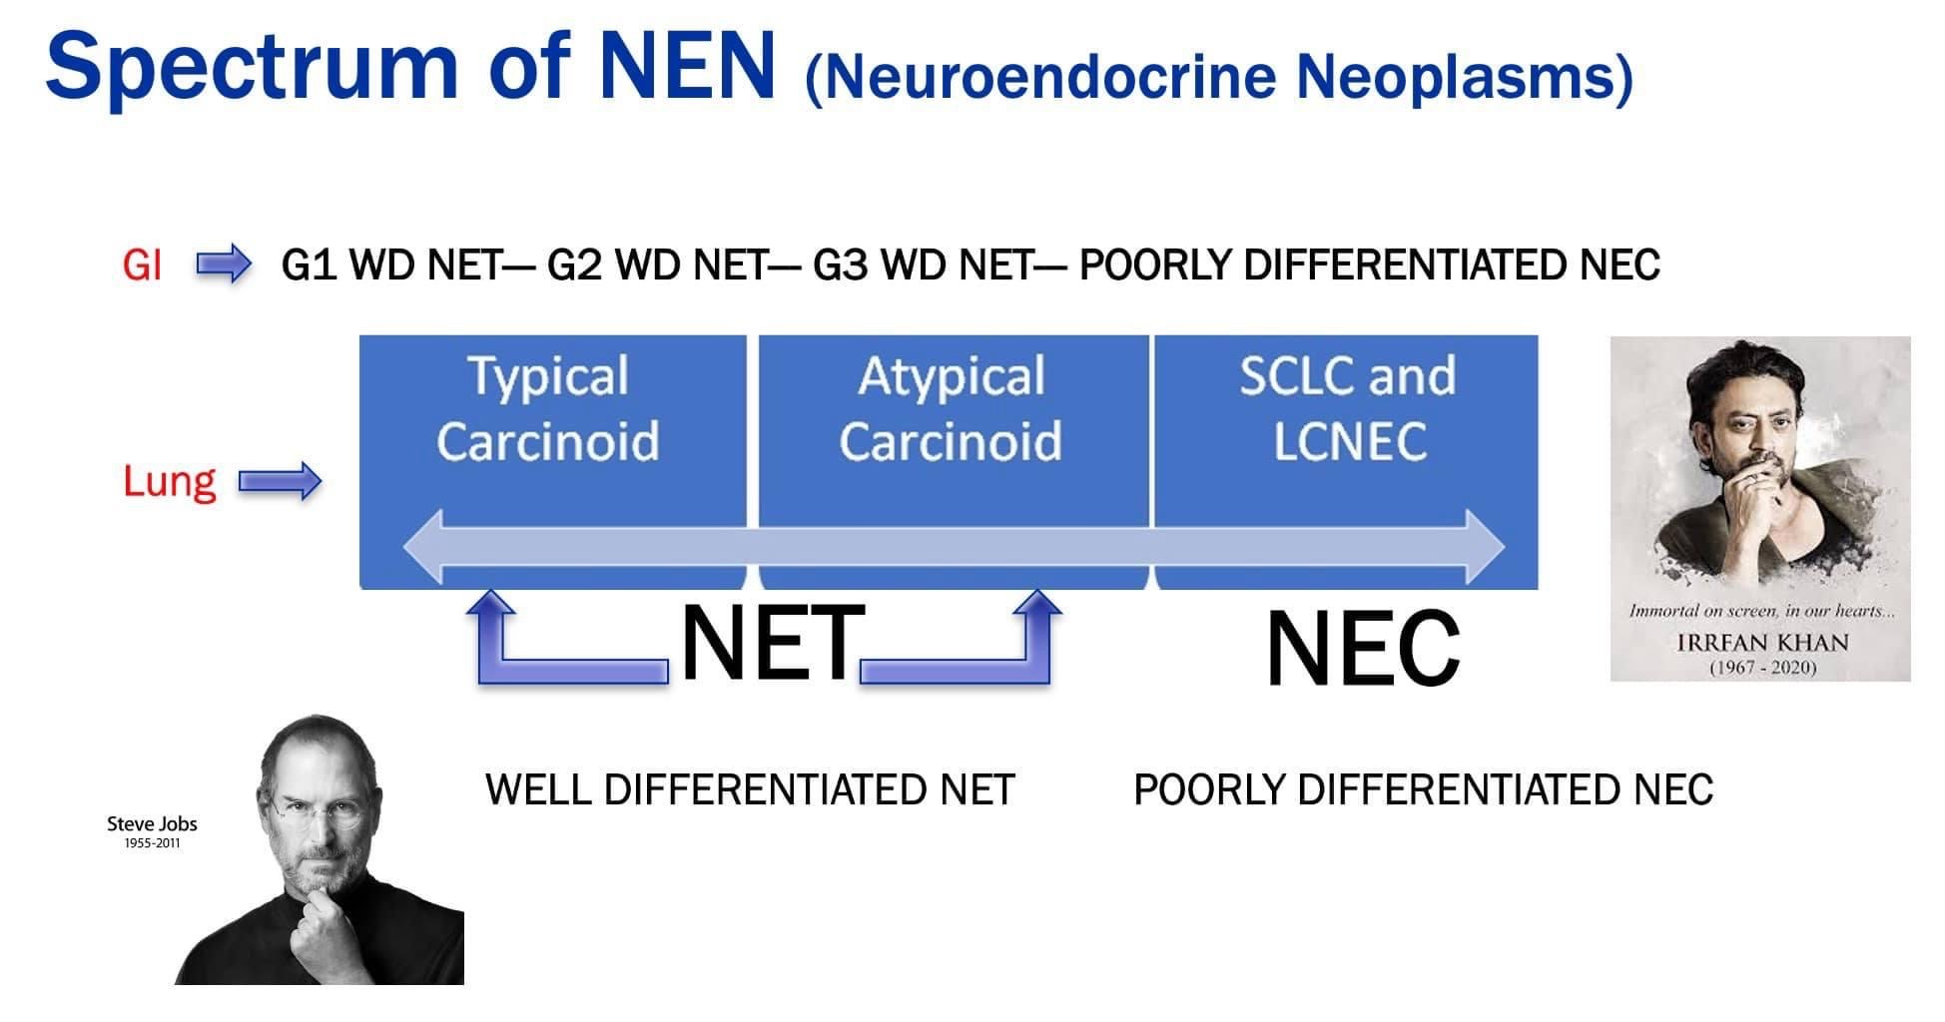

Slide 4
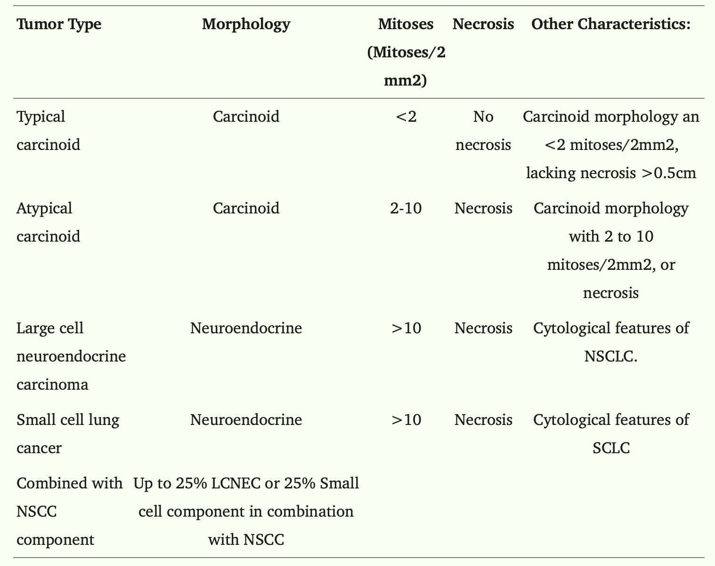
Corbett V and Chauhan A. Management of Large Cell Neuroendocrine Carcinoma.
Front Oncol. 2021

Slide 5
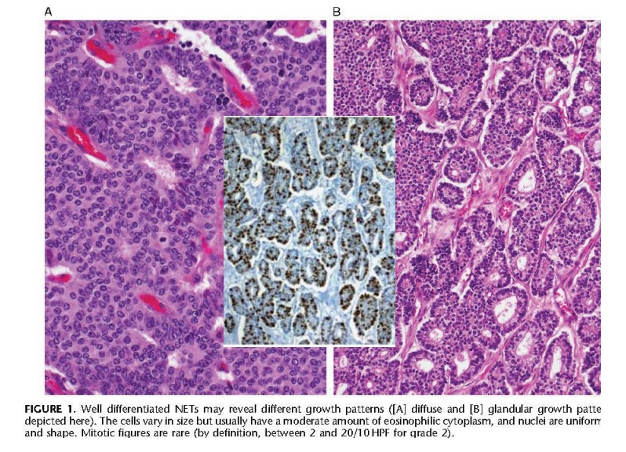
Histopathology: Well Differentiated

Slide 6
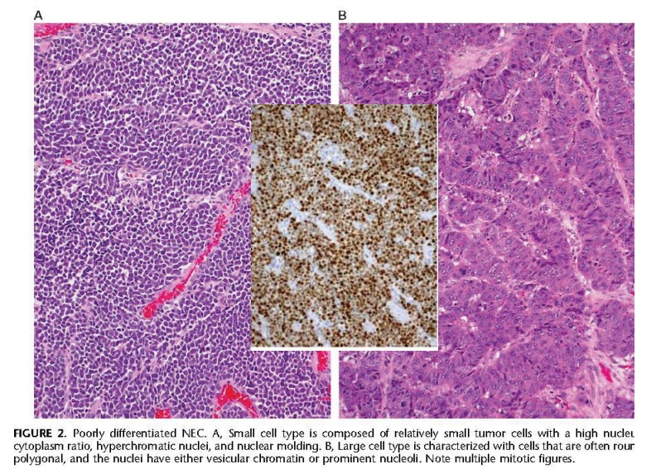
Histopathology: Small Cell/Poorly Differentiated

Slide 7
Neuroendocrine Neoplasm of Lung
NSCLC
SCLC
Carcinoid
LCNC

Slide 8

Pulmonary NENs
Represent a broad spectrum of diseases with biologically distinctive features
Typical carcinoid
Atypical carcinoid
LCNEC
SCNEC
Defined by morphologic and IHC features

Slide 9
Typical and Atypical Lung Carcinoids
Divided into typical and atypical
10:1 ratio
Occur at any age with an average of 45-55 years
Presentation: Asymptomatic, cough, wheezing, carcinoid syndrome, crushing's syndrome, gigantism

Slide 10
Typical Carcinoids
Represent 1-2% of all lung cancers
90% of lung carcinoids
Up to 15% are node positive at presentation
Up to 3% have distant metastasis at presentation

Slide 11
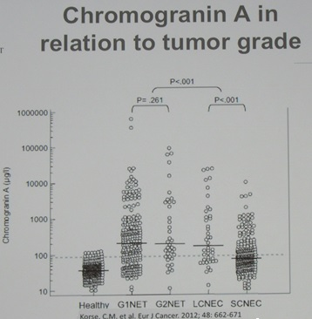
Biochemical Assessment
24 Hr U 5HIAA
Serotonin
Chromogranin A
Serum cortisol
24 hour urine free cortisol
ACTH
GHRH or IGF-1

Slide 12
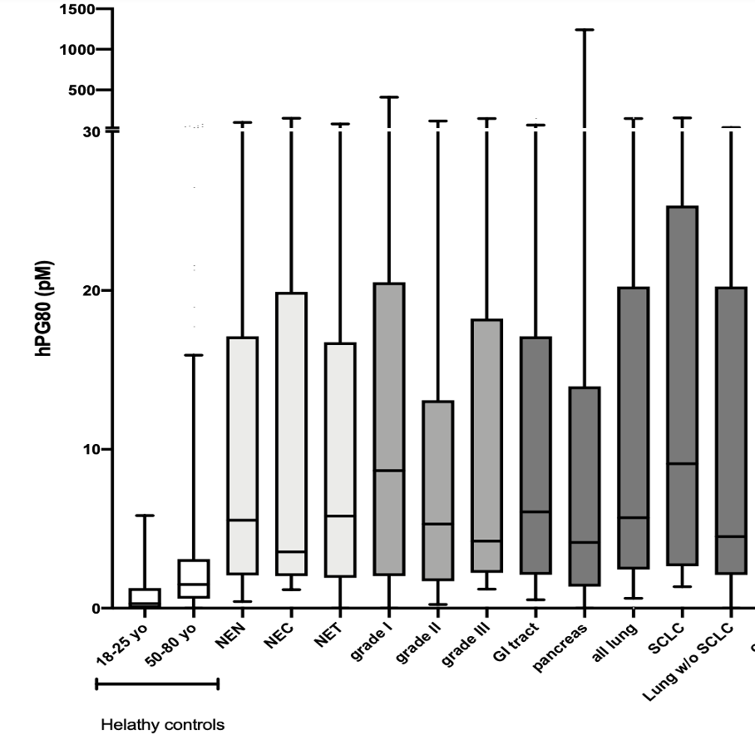
hPG₈₀ (Progastrin) levels in NEN subgroups
1500
1000
500
30
All groups are significantly different from the control groups (Mann Whitney test p<0.0001)
20
hPG₈₀ (pM)
10
0
NEN
NEC
NET
GI
Lung
Grade I
SCLC
18-25 yo
Grade II
NSCLC
50-80 yo
Grade III
Pancreas
Healthy controls
Chauhan A. Cancers 2022

Slide 13
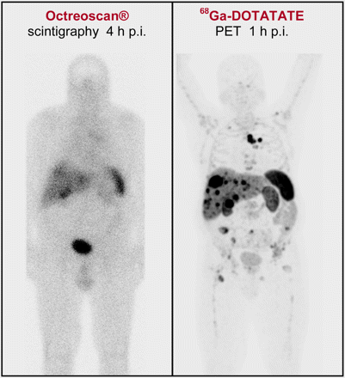
Imaging
Conventional CT
Nuclear medicine
  PET plays role although with lower SUV max (3.6)
    80% positive
  Gallium 68 or Copper 64 dotatate PET/CT

Slide 14
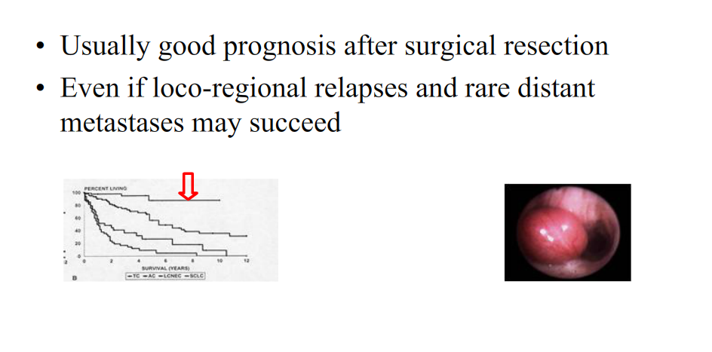
Typical Carcinoid: Prognosis
Guigay, J IASLC WCLC 2013

Slide 15
Atypical Carcinoid
10% of lung carcinoids
40-50% have node positive disease at presentation
Up to 20% have distant metastasis at presentation

Slide 16
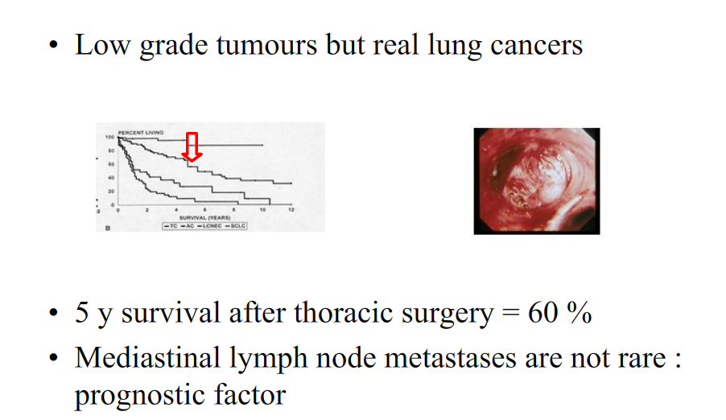
Atypical Carcinoid: Prognosis
Guigay, J IASLC WCLC 2013

Slide 17
Atypical Carcinoid have increased number of mutation in TP53, MEN1, BCL2 and PIK3CA

Slide 18

Treatment
localized disease: the surgical techniques of choice are lobectomy or sleeve resection.
Sub lobar resection is a possible acceptable alternative if complete (R0) resection can be achieved in peripheral <2 cm typical carcinoid

Slide 19
Node positive disease
Worsens prognosis
Adjuvant strategy
  No standard treatment
    Chemo?
    Watch and wait?
  Trials needed!!!

Slide 20
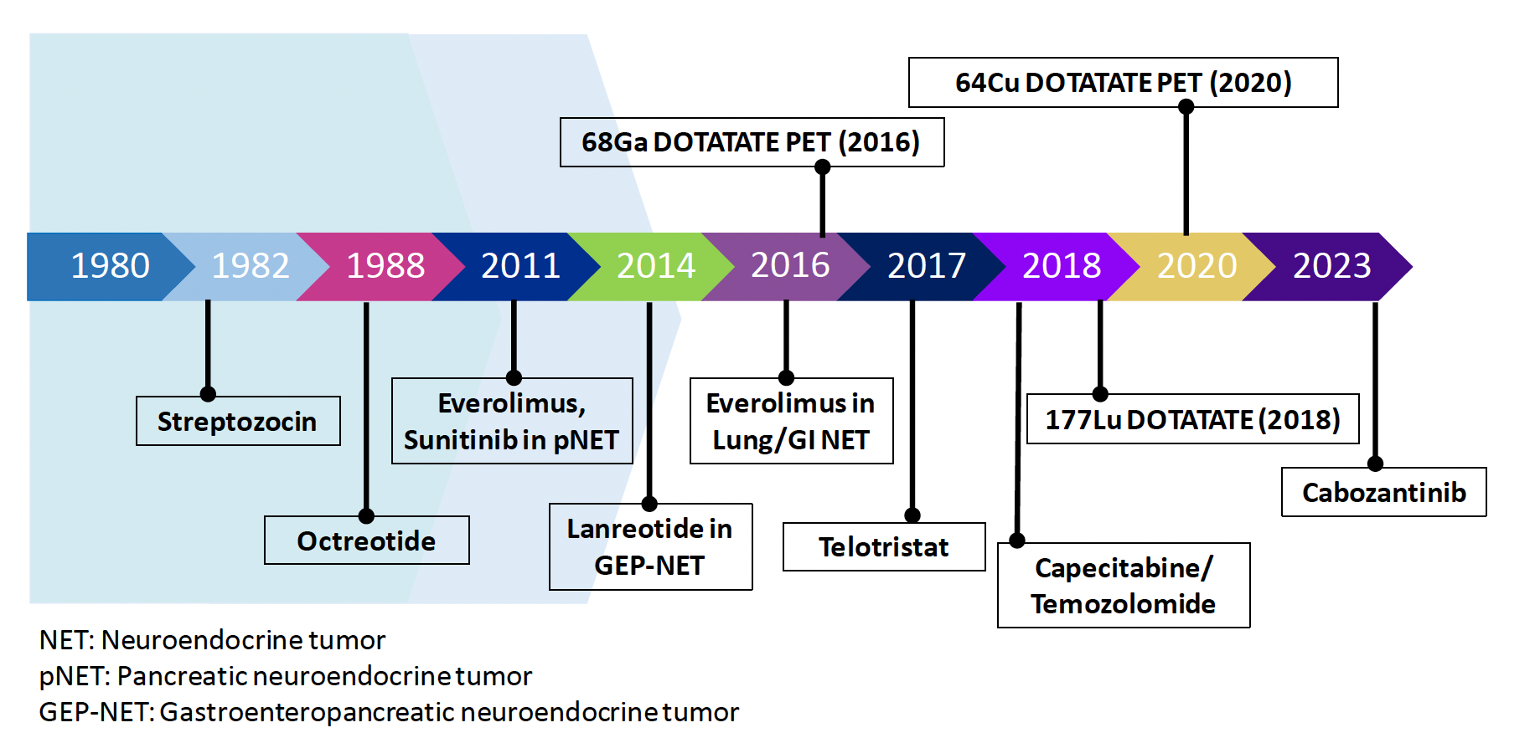
Advances in Neuroendocrine Oncology
Chauhan A. CA: A Cancer Jr of Clinicians 2024: Critical Updates AJCC

Slide 21
Management of metastatic disease?
Somatostatin Analogs?
Targeted therapy?
Chemo?
Radionuclide therapy?

Slide 22
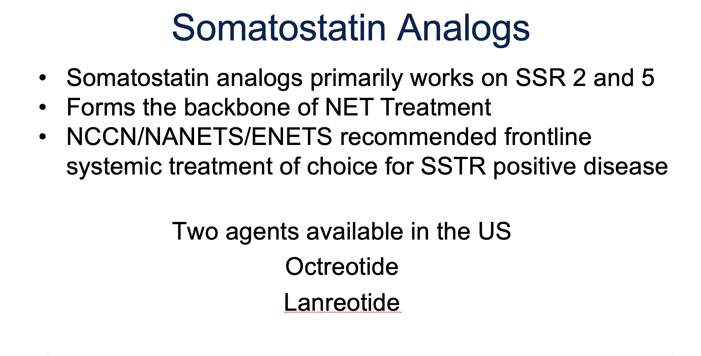

Slide 23
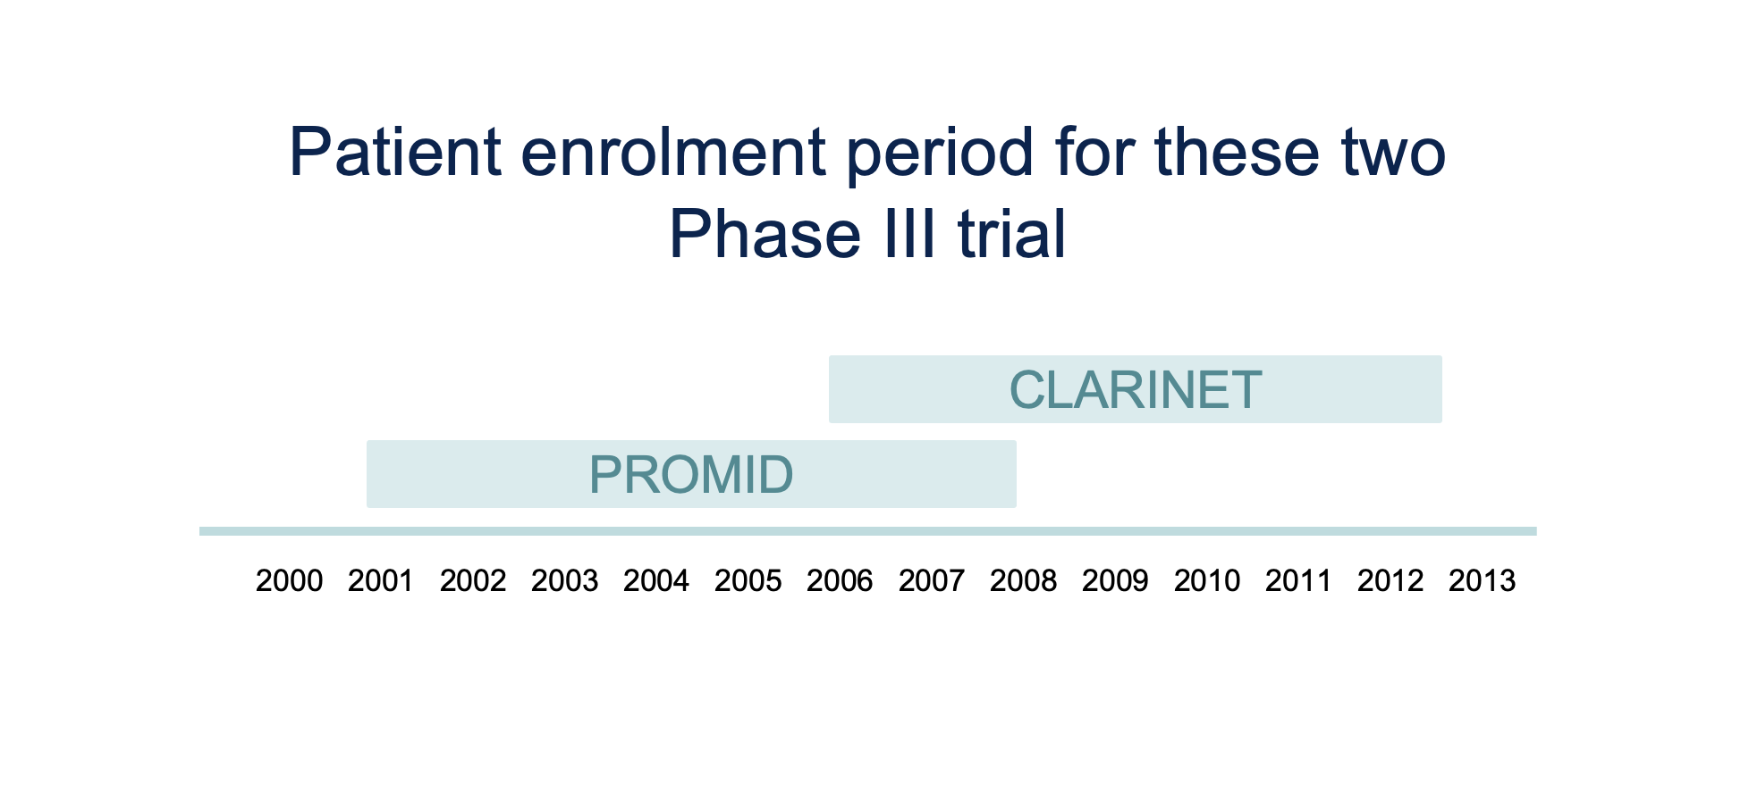

Slide 24
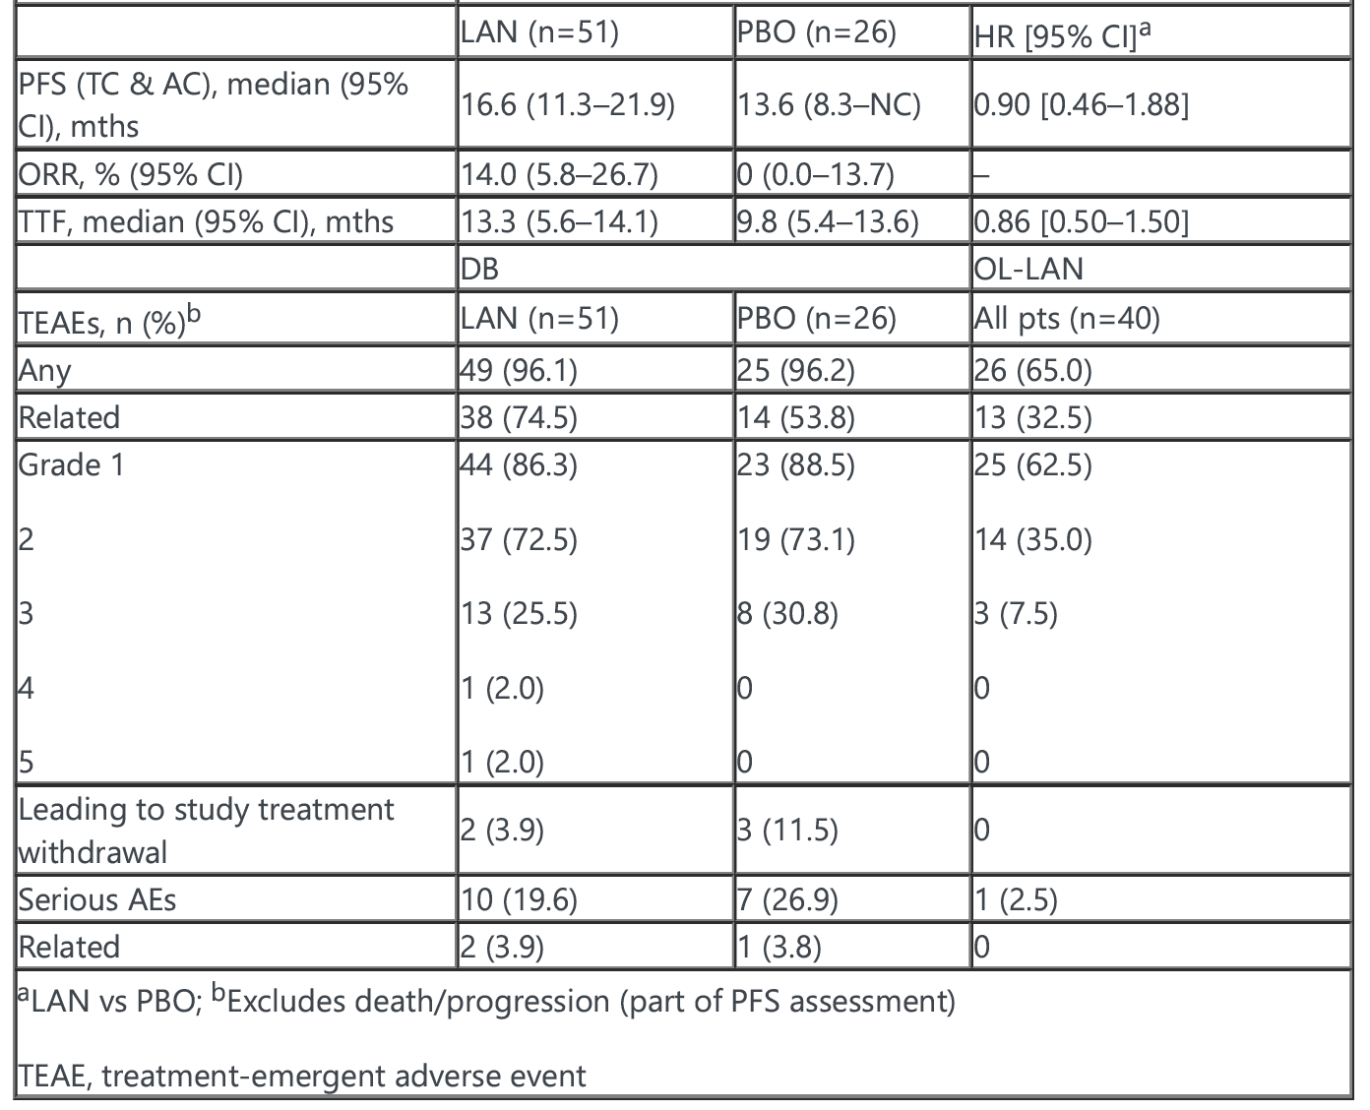
SPINET Study, ESMO 2021

Slide 25
Management of metastatic disease?
Somatostatin Analogs?
Targeted therapy?
Chemo?
Radionuclide therapy?

Slide 26
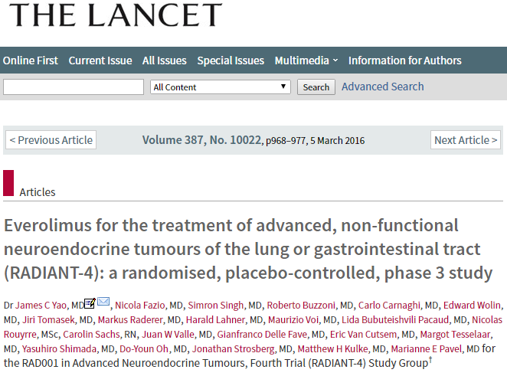
Everolimus
m-TOR inhibitor.
Tested in over 13 K patients in clinical trials and over 23 K commercially.
Approved for NETs based on RADIANT 4 Phase III clinical trial.

Slide 27
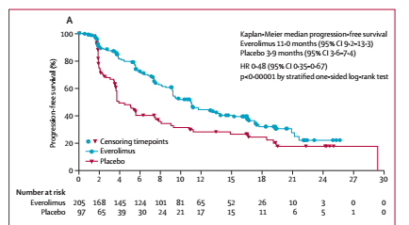
PFS 11 mo VS 3.9 mo

Slide 28
Although approved for Lung NETs , molecular alteration in PI3K/ATK/mTOR pathway is not known to predict treatment response.

Slide 29
Phase 3 Trial of Cabozantinib to Treat Advanced Neuroendocrine Tumors
Jennifer Chan, et al. NEJM. Published September 16, 2024

Slide 30
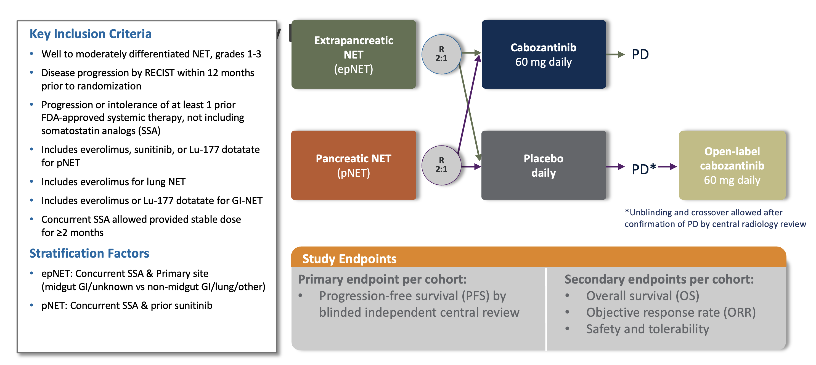

Slide 31
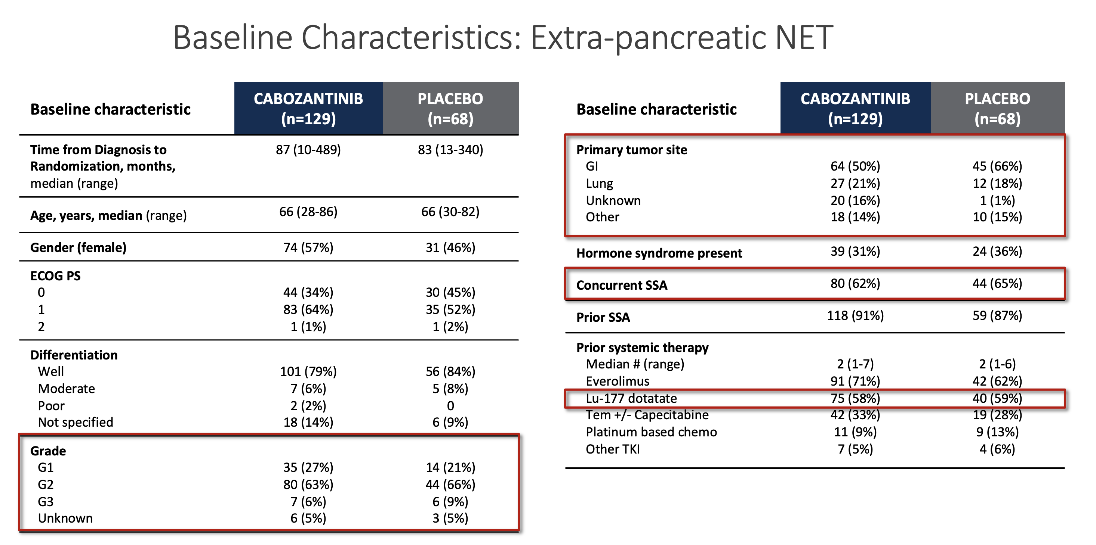

Slide 32
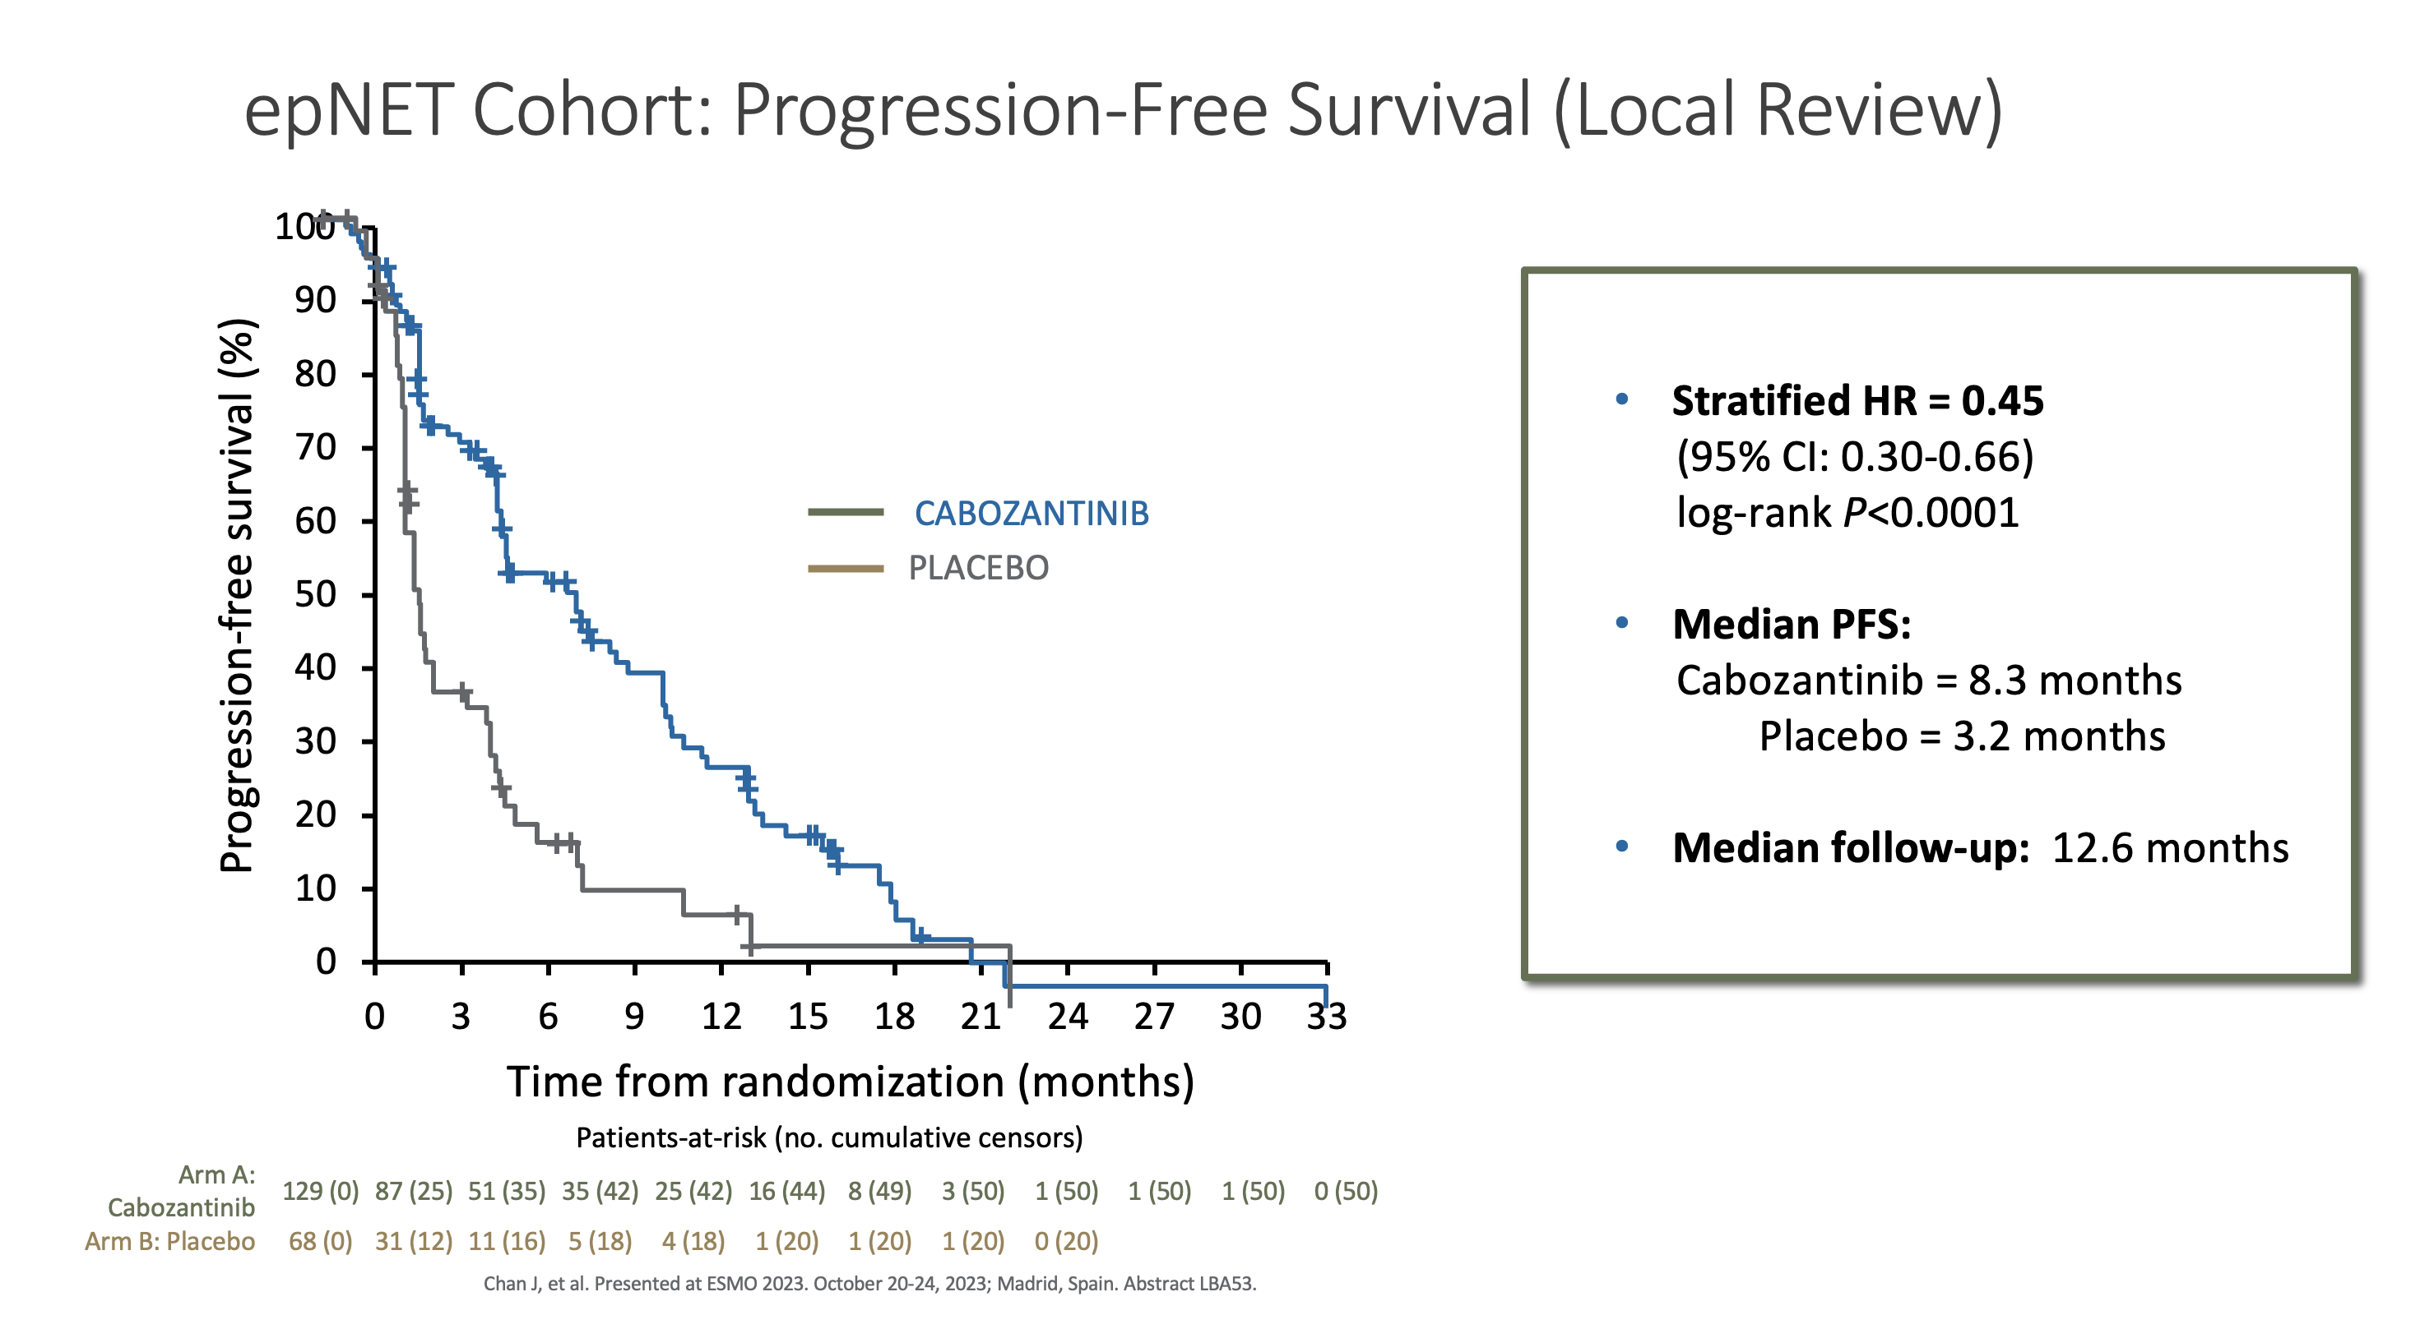

Slide 33
Management of metastatic disease?
Somatostatin Analogs?
Targeted therapy?
Chemo?
Radionuclide therapy?

Slide 34
Role for chemotherapy?
For atypical carcinoids with progressive disease, chemo may be indicated
Platinum based regimen or CAPTEM/Platinum Doublet recommended by NCCN

Slide 35
Management of metastatic disease?
Somatostatin Analogs?
Targeted therapy?
Chemo?
Radionuclide therapy?

Slide 36
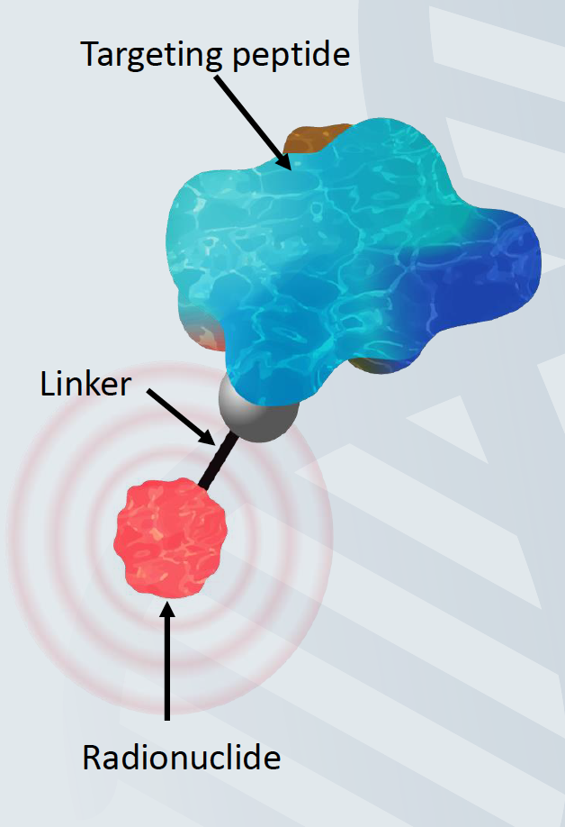
Theranostic
Small amount of radioactive material linked to a cell-targeting agent for the diagnosis and treatment of cancer¹
Gallium 68 dotatate, a radiolabeled somatostatin analog approved to evaluate SSTR status
Lutetium 177 dotatate, a radiolabeled somatostatin analog approved for the treatment of midgut carcinoid tumors²
GrzmilM et al. An Overview of Targeted Radiotherapy. In: J. S. Lewis, A. D. Windhorst and B. M. ZeglisRadiopharmaceutical Chemistry. Springer International Publishing, Cham. 2019:pp85–100;2. LutatheraPrescribing Information. July 2018.Advanced Accelerator Applications, Inc.

Slide 37
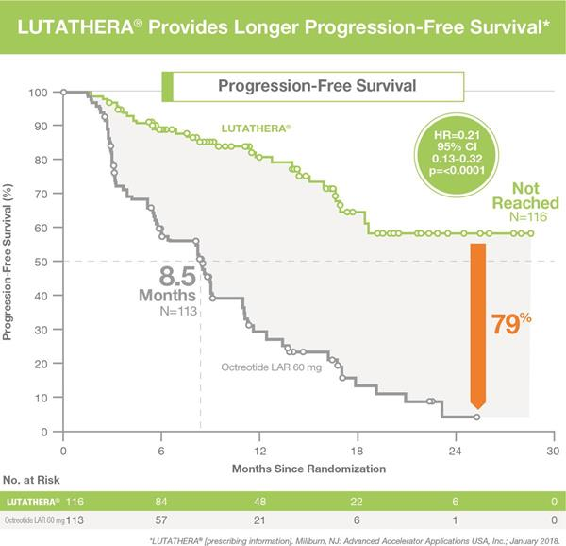
NETTER-1 Phase III RCT: Lu 177 DOTATATE PRRT
Strosberg et. al NEJM 2018

Slide 38
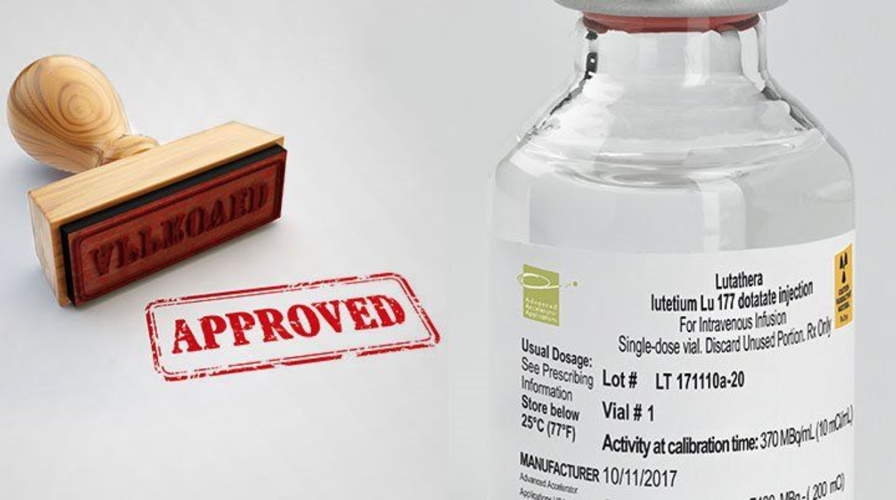
NETTER-1 Phase III RCT: Lu 177 DOTATATE PRRT
Strosberg et. al NEJM 2018

Slide 39
PRRT and LUNG NETs
48 Lung NETs (43 TC, 5 AC) with high SSR treated with Lu-177 dotatate.
At median follow-up of 42 months, the median PFS and OS were 23 months (95% CI 18-28 months) and 59 months (95% CI 50-not reached [NR]), respectively.
Zidan et. al. JNM 2021

Slide 40
A021901: RP2 trial ¹⁷⁷Lu-Dotatate v Everolimus in WD lung NET
Inclusion criteria
Bronchial carcinoid (WD-typ/MD-atyp
SSTR+
Radiographic progression within 12 mo (and measurable)
4 q8¹⁷⁷Lu-DOTATATE
200 mCi x w
1:1
Crossover
on PD
Everolimus
10 mg Qd
Stratification: prior/concurrent SSA
Iº endpoint: PFS by real time PD central review
Activation: 09/2021
Accrued/N: 0/108
Hope and Padda for Alliance/ECOG-ACRIN
Notes:
From Tom 2/9/21: May 3rd is our open date. It is CIRB approved, just awaiting contracting and CTEP sign off…. There has been no substantive changes to the design so you can use the slides from the last NET TF meeting.

Slide 41
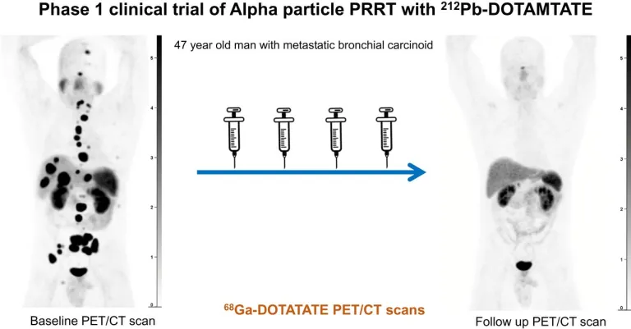
ALPHAMEDIX02: Multicenter Phase 2 study of 212Pb-DOTAMTATE enrolling adult subjects with positive somatostatin positive neuroendocrine tumors with no prior history of peptide receptor radionuclide therapy (PRRT naive)
Purpose: evaluate the efficacy of 212Pb-DOTAMTATE (alpha-emitter) in patients somatostatin positive neuroendocrine tumors with no prior history of peptide receptor radionuclide therapy (PRRT naive)
ClinicalTrials.gov: NCT05153772

Slide 42
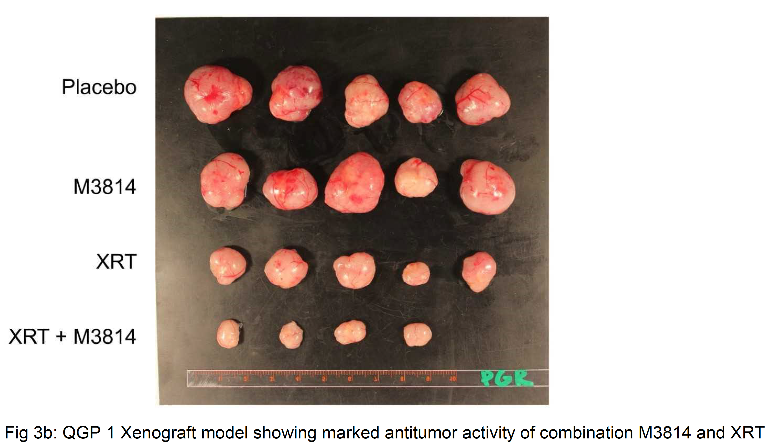
M3814 (Peposertib) +XRT in vivo data
Chauhan et. al Oral Presentation NANETS (Boston) 2019

Slide 43
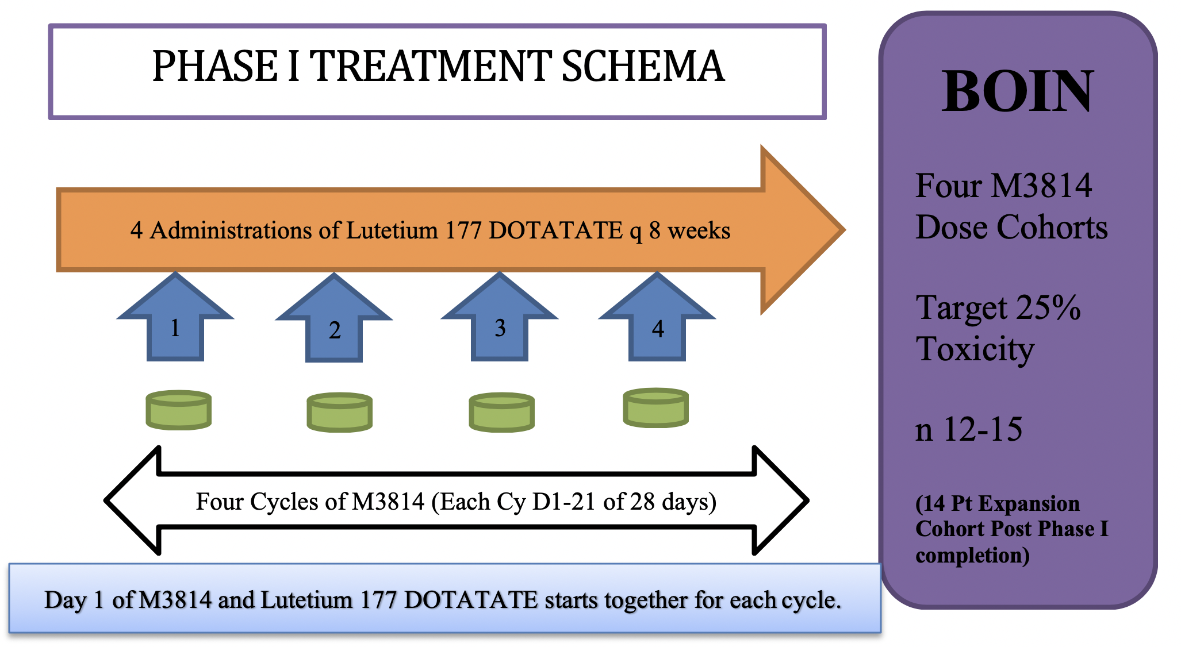
A Phase I Trial of Peposertib and Lutetium Lu 177 Dotatate in Combination for Well-Differentiated Somatostatin Receptor-Positive Neuroendocrine tumors
NCI CTEP Career Development Award-2020
(ETCTN 10450; National Co-PI: Aman Chauhan)

Slide 44
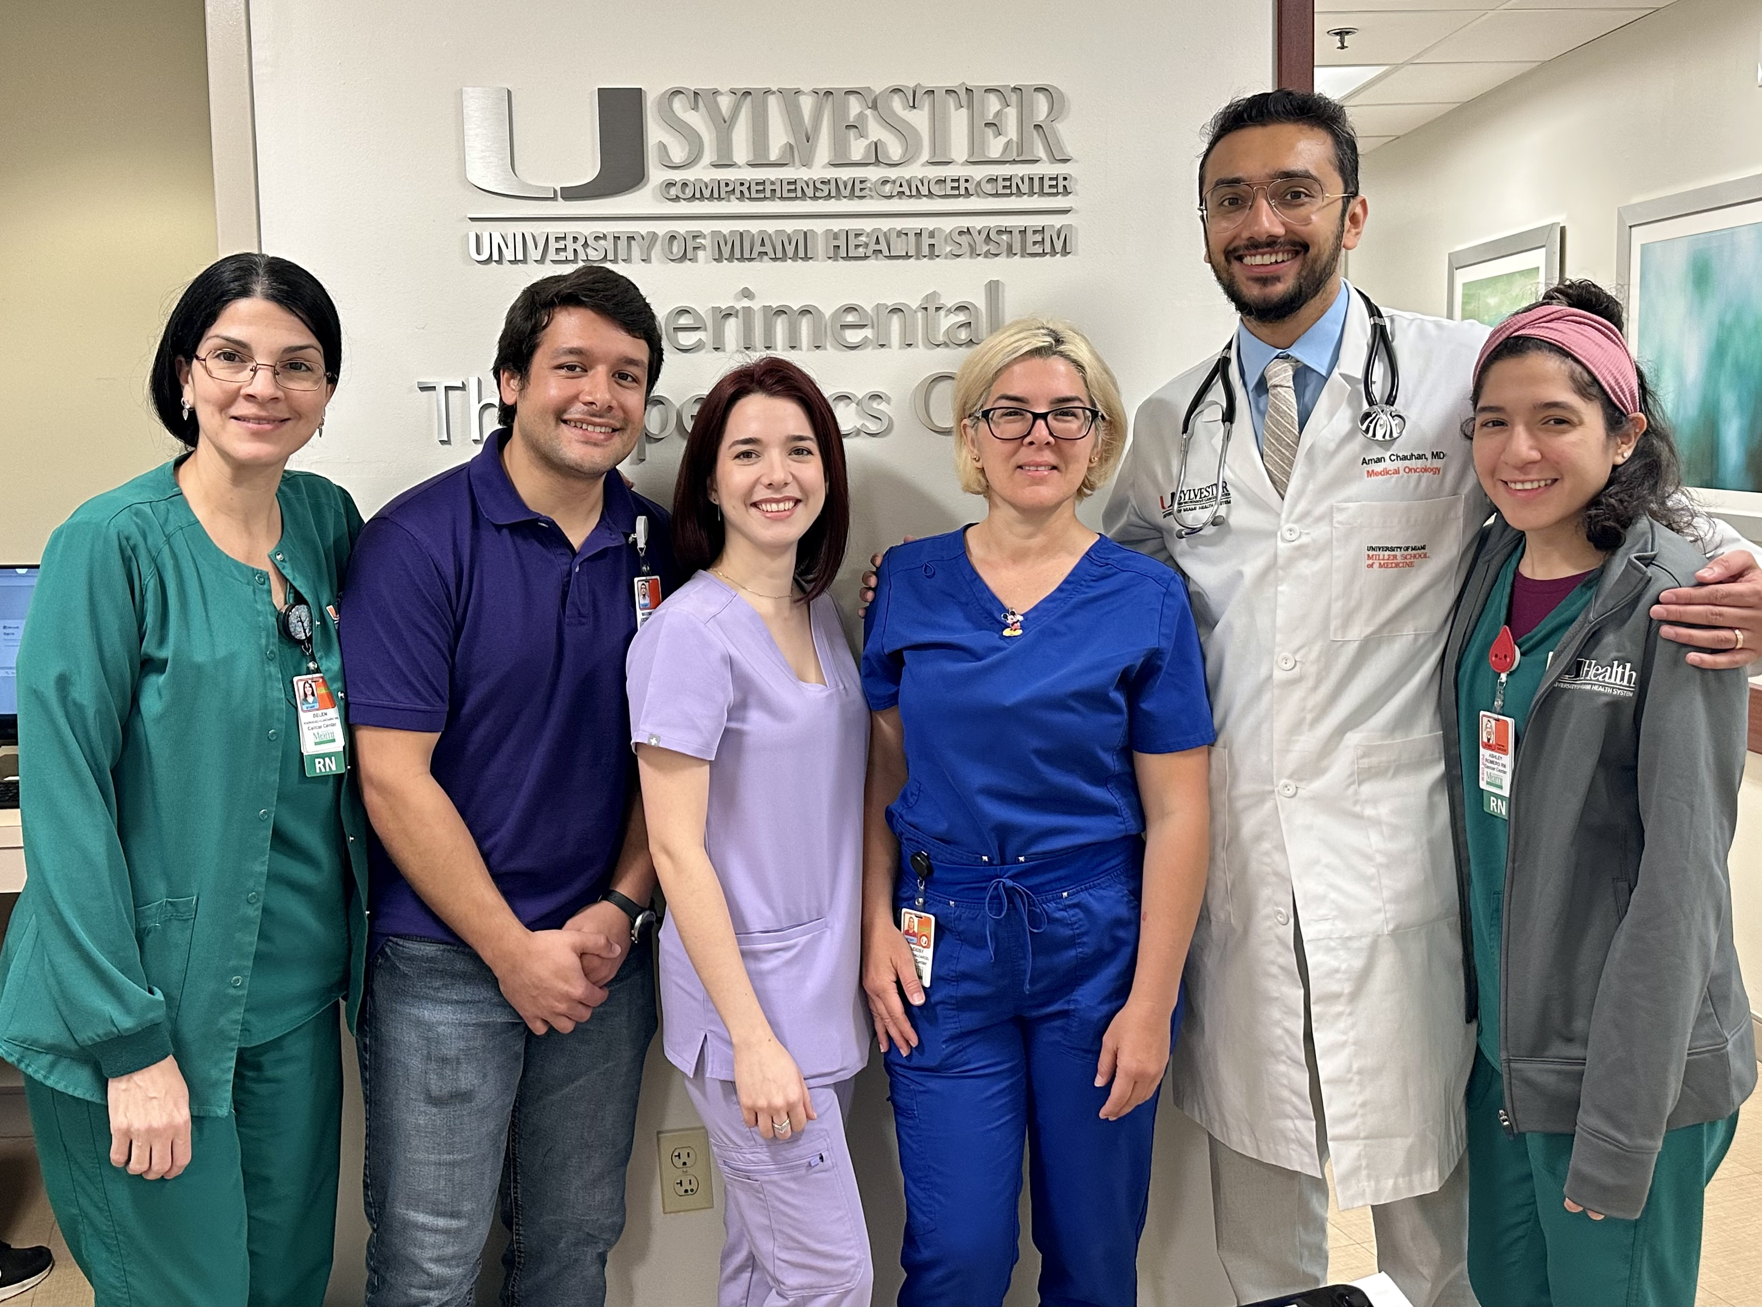

Slide 45
Telotristat Ethyl
A Tryptophan Hydroxylase (TPH) Inhibitor
Serotonin Synthesis in Carcinoid Tumor Cells
Telotristat ethyl is a novel oral inhibitor of TPH, the rate-limiting enzyme in serotonin biosynthesis¹
Two early-stage clinical studies of telotristat etiprate demonstrated a favorable safety profile and evidence of clinical activity in carcinoid syndrome^{2,3}
Both preclinical and clinical studies suggested that telotristat etiprate is associated with minimal CNS activity¹⁻³
Granted Fast Track Status and
Orphan Drug Designation⁴
Telotristat
Ethyl

Tryptophan
5-HTP
5-HT
TPH
5-HT secretion
5-HT in blood
5-HIAA
5-HIAA filtered by kidney
5-HIAA in urine
Monoamine oxidase
Aldehyde dehydrogenase
5-HIAA, 5-hydroxyindoleacetic acid; 5-HT, serotonin; 5-HTP, hydroxytryptophan; CNS, central nervous system; TPH, tryptophan hydroxylase.
1. Liu Q, Yang Q, Sun W, et al. J Pharmacol Exp Ther 2008; 325:47–55. 2. Kulke MH, O'Dorisio T, Phan A, et al. Endocr Relat Cancer 2014;21:705–714. 3. Pavel M, Horsch D, Caplin M, et al. J Clin Endocrinol Metab 2015;100:1511–1519. 4. FDA Orphan Drug Designations. Available at: http://www.accessdata.fda.gov/scripts/opdlisting/oopd/index. Accessed September 2015. 5. Kronenberg HM, Melmed S, Polonsky KS, et al. Williams Textbook of Endocrinology, 11th edn. 2008:1823–1824.
Notes:
45

Slide 46
TELESTAR: Mean Absolute Change in Urinary 5-HIAA (mg/24 h) from Baseline to Week 12
n=29
n=32
n=31
All patients continue SSA therapy throughout study period. Data include only patients for whom both baseline and Week 12 assessments were available.
Wilcoxon rank-sum test showed significant differences for each telotristat etiprate dose vs. placebo (p<0.001)

Slide 47
Once-daily Oral Paltusotine in the Treatment of Patients With Carcinoid Syndrome: Results From a Phase 2, Randomized, Parallel-Group Study
Presenter: Aman Chauhan, MD
NANETS Multidisciplinary NET Medical Symposium ● November 21-23, 2024 ● Chicago, Illinois, USA

Slide 48
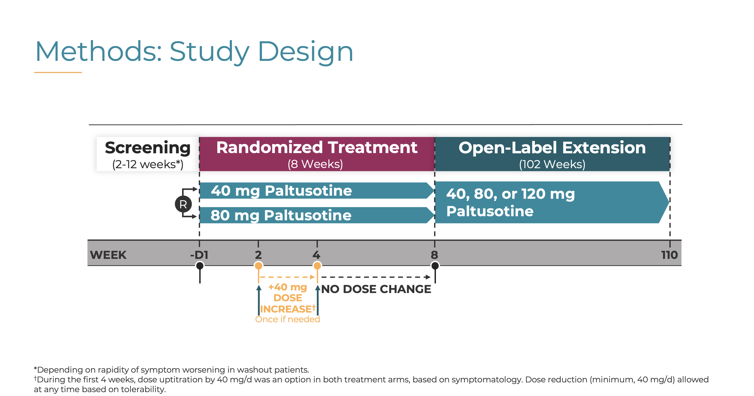
Chauhan A. NANETS 2024

Slide 49
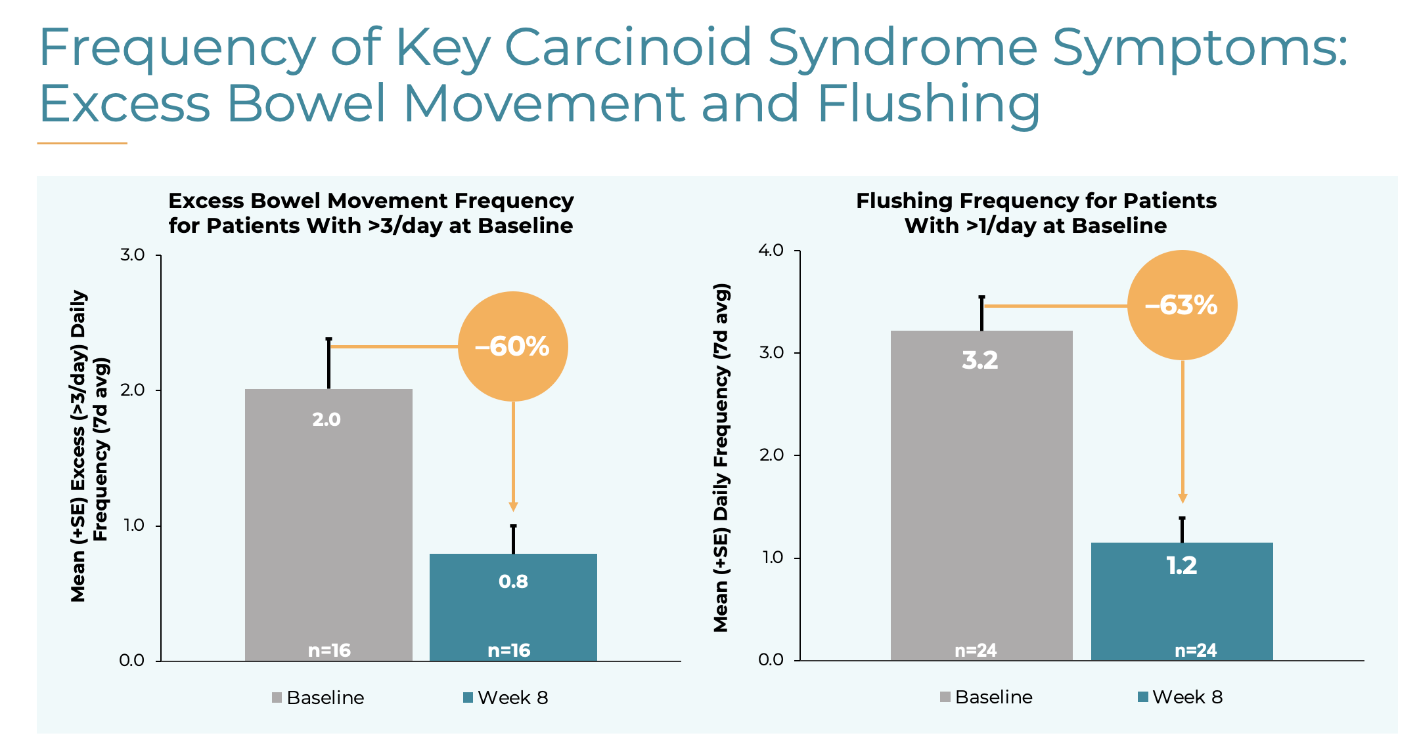
Chauhan A. NANETS 2024

Slide 50
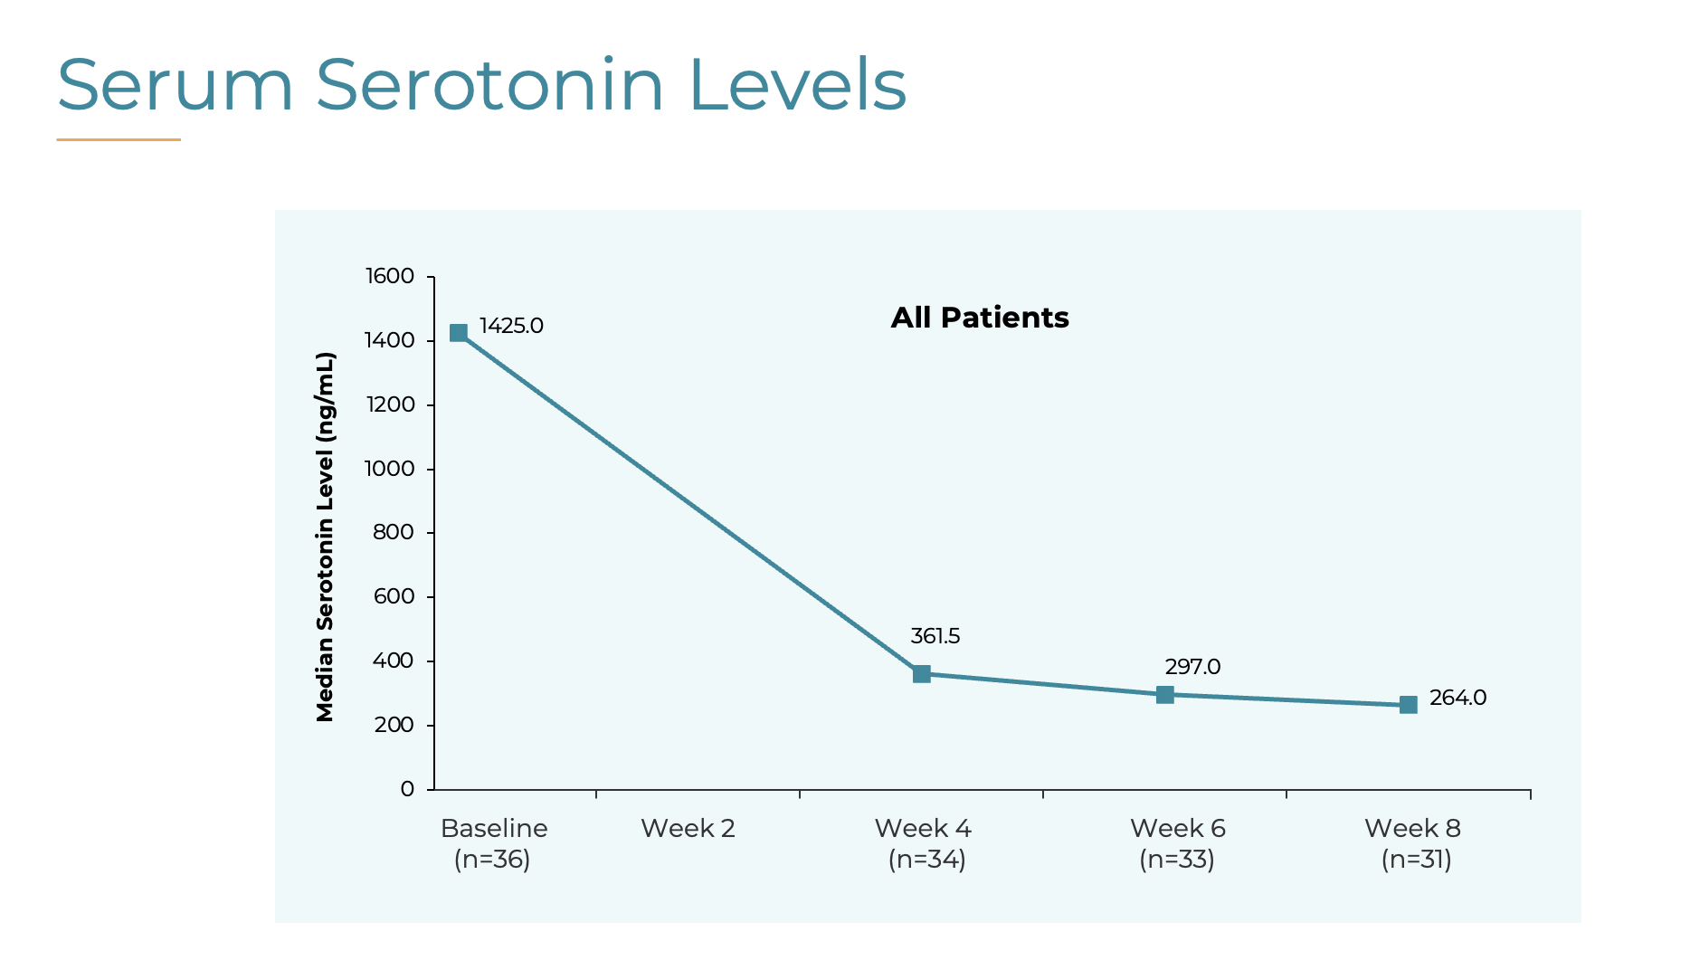
Chauhan A. NANETS 2024

Slide 51
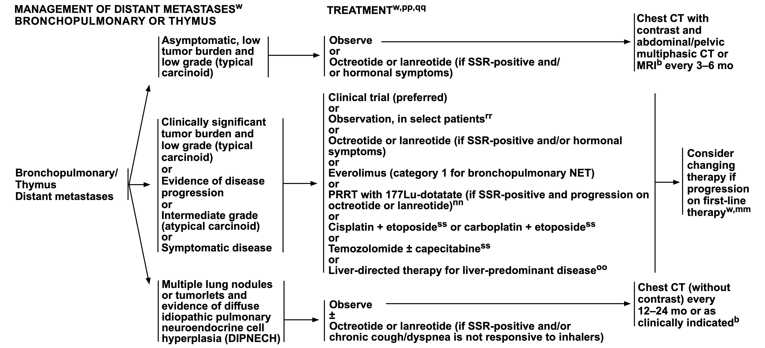
Management Options

Slide 52
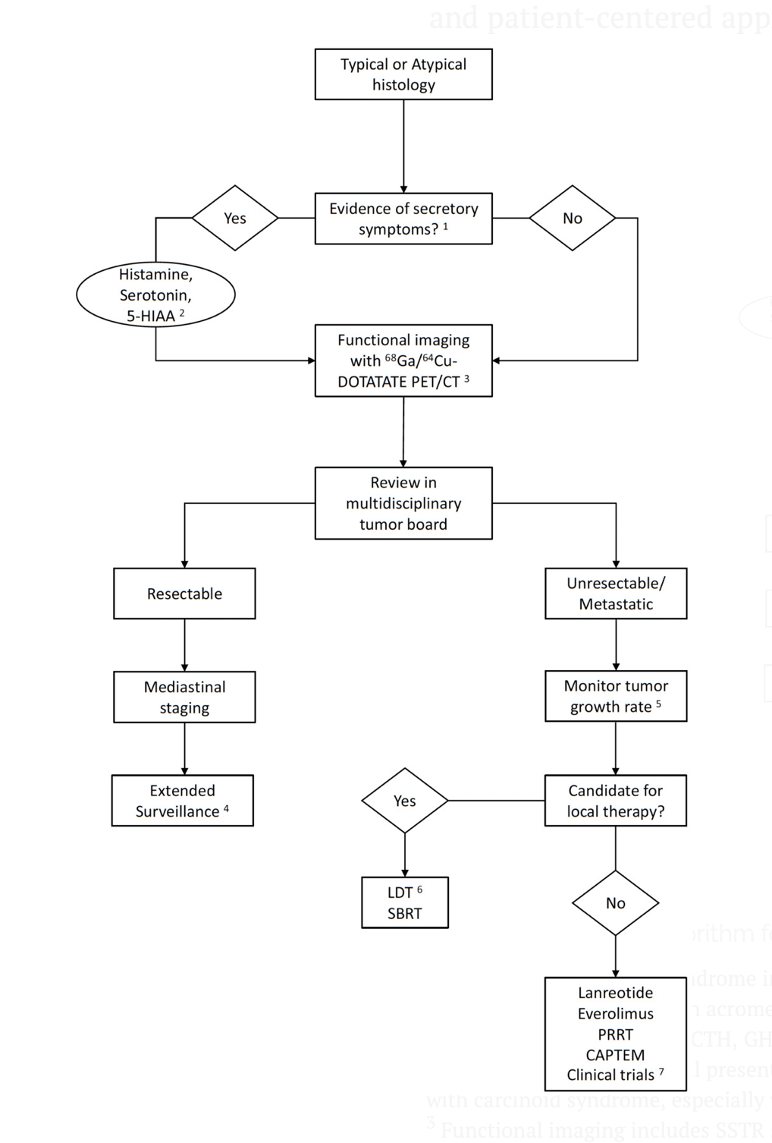
Management of typical and atypical carcinoids
Gupta G, Ramirez RA, Chauhan A.
Management of bronchopulmonary neuroendocrine tumors. IJCCD. 2022

Slide 53
Neuroendocrine Carcinomas
Rapid doubling time, high growth fraction, and the early development of widespread metastases
Although considered highly responsive to chemotherapy and radiotherapy, usually relapses within two years despite treatment
Overall, only three to eight percent of all patients with SCLC (10 to 13 percent of those with limited disease) survive beyond five years

Slide 54
Clinical Presentation (SCLC)
Rare to be diagnosed in early stage
Brain (30%)
Adrenal (20-40%)
Liver (25%)
Lung
Skeleton (35%)

Slide 55
SCLC Paraneoplastic Syndromes
SIADH (cisplatin, opiates can also cause hyponatremia)
Ectopic ACTH production- Cushing’s syndrome
Eaton-Lambert Myasthenic syndrome
  proximal muscle weakness that improves on repetition (“facilitation”)
Hypercalcemia
Peripheral Neuropathy/encephalomyelitis (anti HU; order paraneoplastic panel)

Slide 56
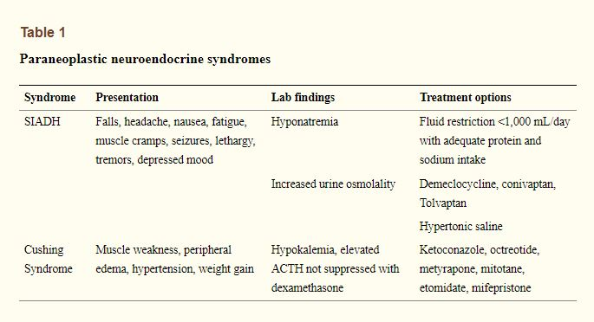
Two most common neuroendocrine paraneoplastic syndromes

Slide 57
SCLC Staging
NCCN recommends incorporation of both Old VA Classification and TNM classification
VA: Limited Stage
Confined to ipsilateral hemithorax and can be covered in a radiation field
Extensive Stage
Beyond ipsilateral hemithorax, distant mets, pleural effusion

Slide 58
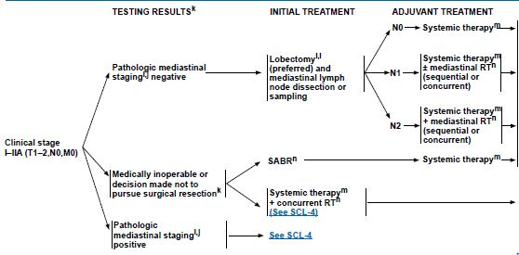

Surgical Treatment for Stage I

Slide 59
Limited vs. Extensive stage
 | Limited stage | Extensive stage
Incidence | 1 out of 3 people with SCLC | 2 out of 3 people with SCLC
Spread | Only in one lung and perhaps in lymph nodes on the same side of the chest | To other lung, to lymph nodes on the other side of the chest, or to distant organs
Area | confined to an area | Wide spread
Treatment | chemo-radiation ± PCI | Chemotherapy/Immuno± PCI
Notes:
Due to the high rate of early metastases, chemotherapy is an integral part of treatment for all stages of SCLC

Slide 60
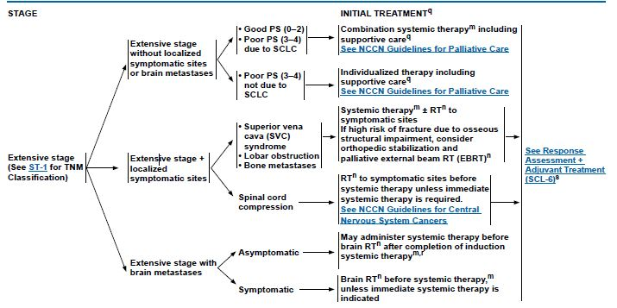
NCCN Guidelines: First line Setting

Slide 61
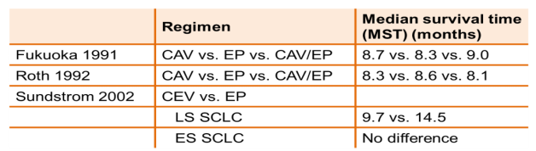
First Line Therapy
During the 1970s CAV (cyclophosphamide, adriamycin, and vincristine) was the standard regimen
In the 1980s several phase III clinical trials demonstrated that EP (Etoposide + Platinum) was equivalent to CAV

Slide 62
Carboplatin vs Cisplatin
In clinical practice, carboplatin is frequently substituted for cisplatin to reduce the risk of emesis, neuropathy, and nephropathy.
The use of carboplatin carries a greater risk of myelosuppression
Randomized trials have suggested similar efficacy of cisplatin and carboplatin in patients with extensive stage small cell lung cancer

Slide 63
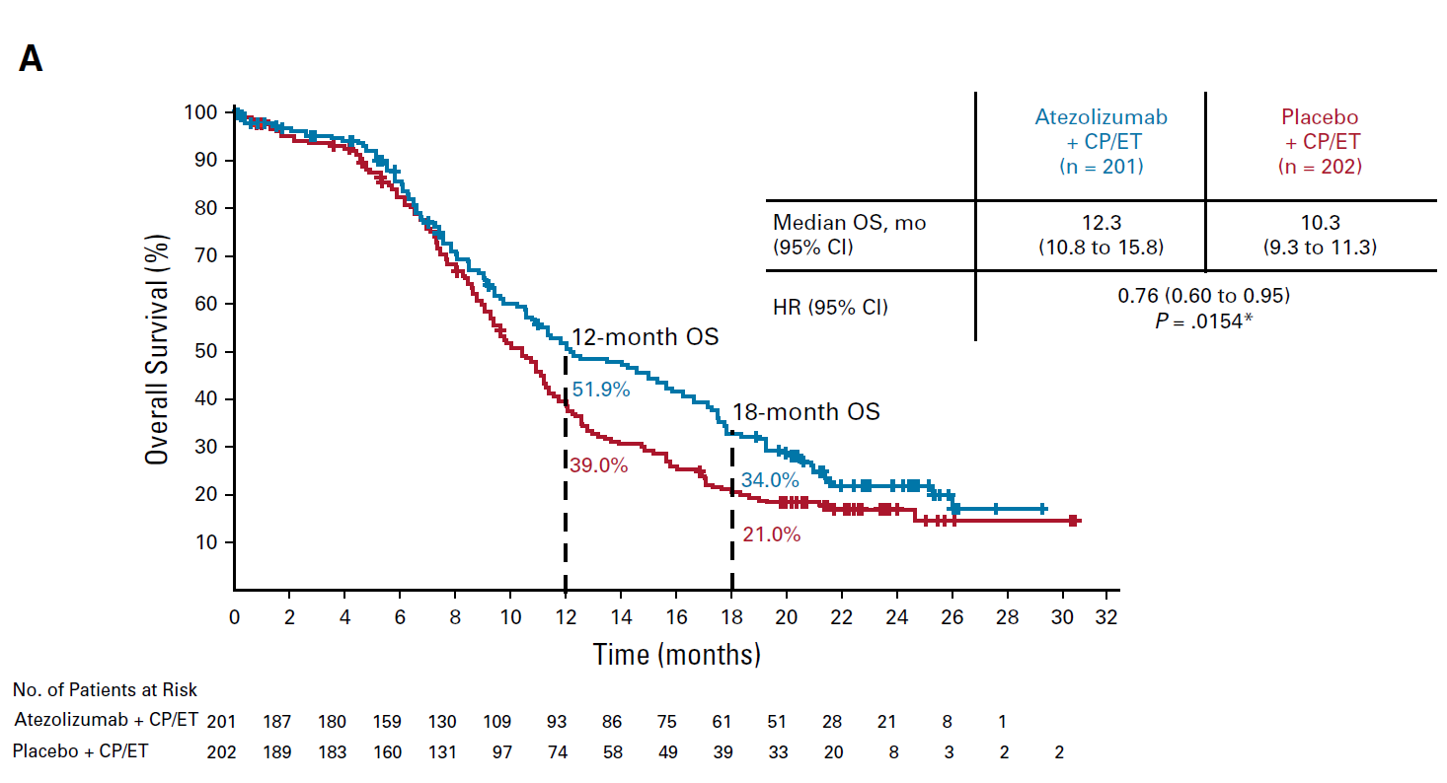
Immunotherapy 1st line advanced SCLC
Impower 133 Carbo+Etop +/- Atezo then Atezo maintenance: Overall Survival (Median F/U 22.9 mos)
  Given much censorship of data past 18 mos, implications for long term survival with added atezo are pending.
  Since there are 5 year OS advantages for NSCLC with added immune checkpoint inhibitors, and the great importance of this outcome, this is a key question.
Hazard Ratio 0.79
Liu. JCO 2021; 39:619-630

Slide 64
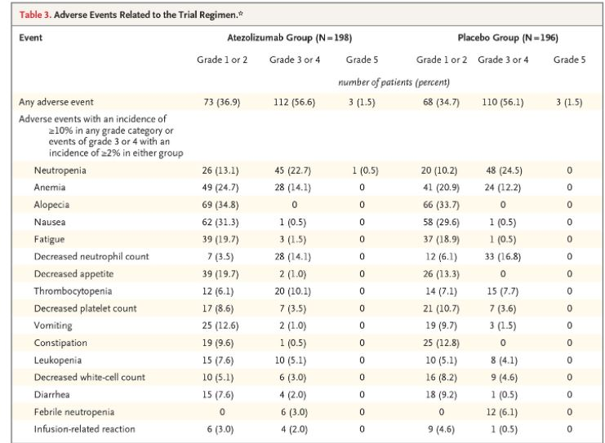
Immunotherapy 1st line advanced SCLC
Impower 133 Carbo+Etop +/- Atezo then Atezo maintenance: Toxicity
No clear increased toxicity with added atezo
Liu. JCO 2021; 39:619-630

Slide 65
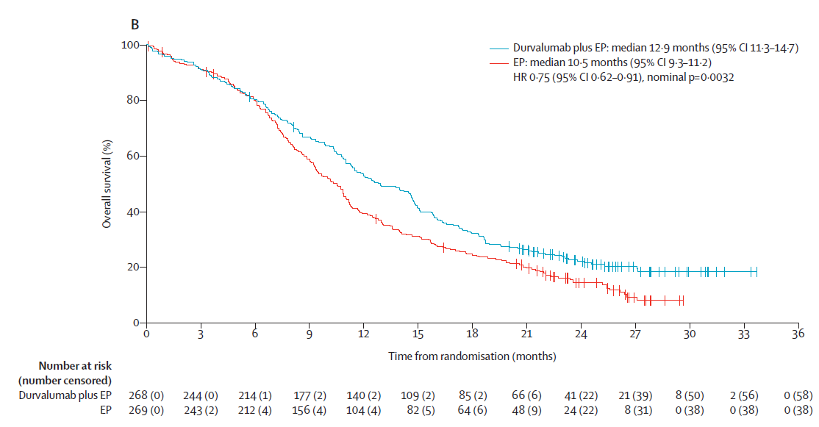
Immunotherapy 1st line advanced SCLC
CASPIAN: Platinum+Etop +/- Durva then maintenance Durva: OS (Median F/U 25.1 mos)
  Given much censorship of data past 20 mos, implications for long term survival with added Durva are pending.
  Since there are 5 year OS advantages for NSCLC with added immune checkpoint inhibitors, and the great importance of this outcome, this is a key question.
Hazard Ratio 0.75
Chemo + Durva
Chemo
Goldman , Lancet Oncol,2021

Slide 66
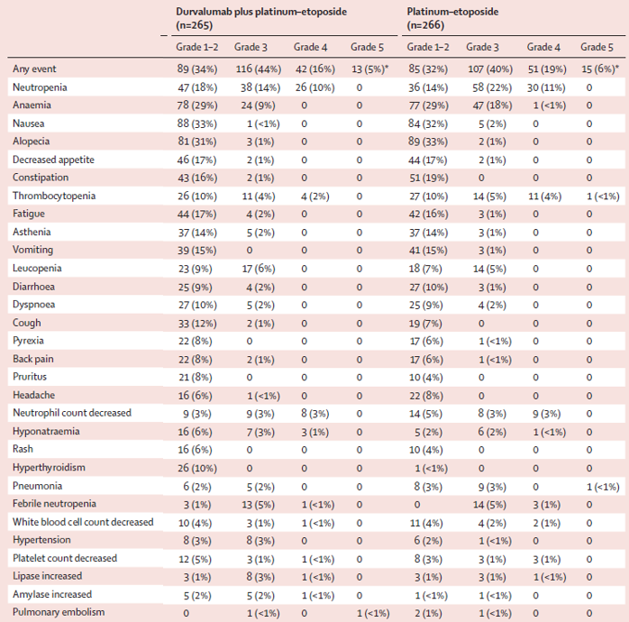
Immunotherapy 1st line advanced SCLC
CASPIAN: Platinum+Etop +/- Durva then maintenance Durva: Toxicity
No clear increased toxicity with added Durva
Goldman , Lancet Oncol,2021

Slide 67
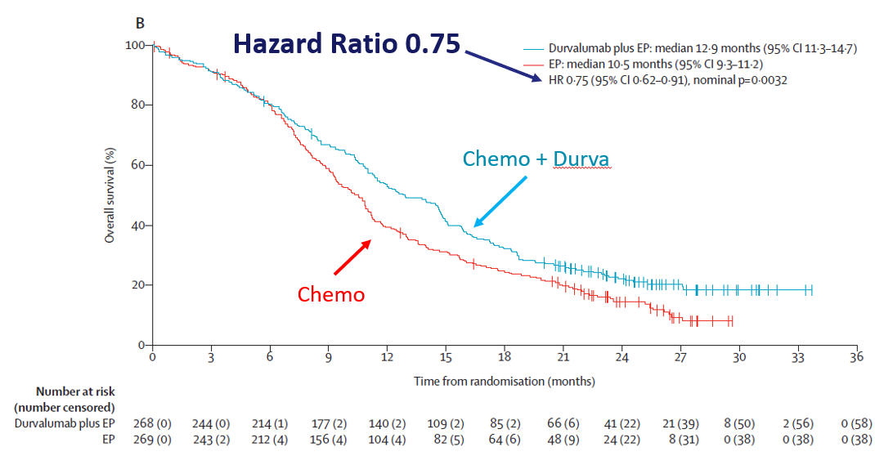
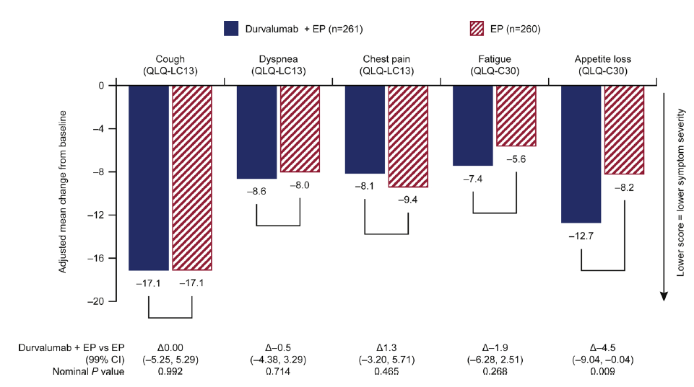
Immunotherapy 1st line advanced SCLC
CASPIAN: Platinum+Etop +/- Durva then maintenance Durva: Pt. Reported Outcomes
It is a win-win:
Chemo-Durva improves well being and OS
OS
In the Durva arm:
  Longer time to deteriation of symptoms
  Improvement in appetite was statistically significantly improved
QOL (QL!-LC13)
Adjusted median change from baseline
Lower score = lower symptom severity with
Goldman , Lung CA,2020

Slide 68
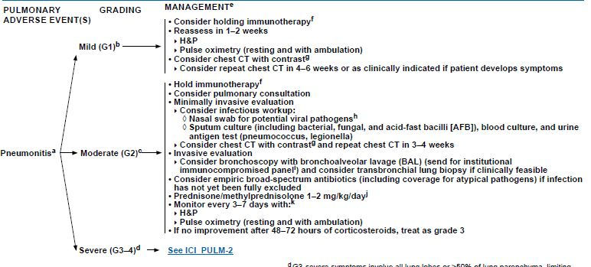
Serious immune checkpoint inhibitor induced Pneumonitis must be treated quickly.
This is to reduce risk of death.
Sometimes unclear as to cause of DOE and CT findings. Consult with pulmonologist. If fair chance ICI induced, even if not sure, may need to treat with a prolonged course high dose steroids as per guidelines often over 4-8 weeks slow taper.

Slide 69
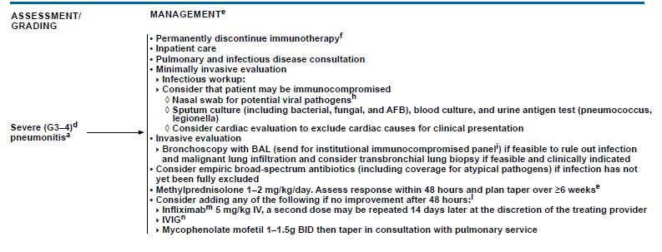
Serious immune checkpoint inhibitor induced Pneumonitis must be treated quickly.
This is to reduce risk of death.
For severe pneumonitis, further considerations:

Slide 70
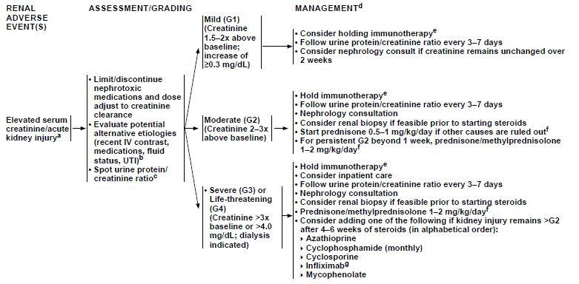
Managing patients with immune related adverse event (renal toxicities)

Slide 71
Patient Selection for Immune Checkpoint Inhibitors
No predictive biomarkers
Frequency of PD-L1 expression in SCLC tends to be lower compared with NSCLC
A subgroup analysis of IMpower 133 evaluated the impact of PD-L1 expression on OS.
  No differences were found and patients benefited from addition of atezolizumab regardless of PD-L1 expression
In CASPIAN trial, OS benefit with durvalumab-PE was seen regardless of PD-L1 expression
TMB is an emerging biomarker independent of PD-L1 expression. High TMB correlates with increased ORR to ICI
  CASPIAN trial TMB was not predictive of OS improvement
  IMpower133 TMB did not show any difference in OS
Ortega-Franco A et al. ESMO Open. 2021 Epub ahead of print; Liu SV et al. JCO 2021; 39: 619-630
Notes:
https://www.ncbi.nlm.nih.gov/pmc/articles/PMC7811117/

Slide 72
Second Line Therapy
Although SCLC is very responsive to initial treatment, most patients relapse with relatively resistant disease
These patients have a median survival of only 4 to 5 months when treated with further chemotherapy
Second line and third line chemotherapy provides significant palliation in many patients, although the likelihood of response is highly dependent on the time from initial therapy to relapse
  If the interval is less than 3 months, response to most agents is poor (<10%)
  If interval is more than 3 months, then the expected response rates are approximately 25%
If patients relapse more than 6 months after first line treatment, then treatment with their original regimen is recommended

Slide 73
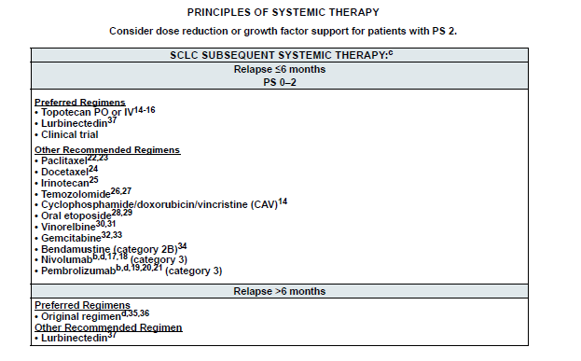
Subsequent Therapy

Slide 74
Clinical Trials

Slide 75
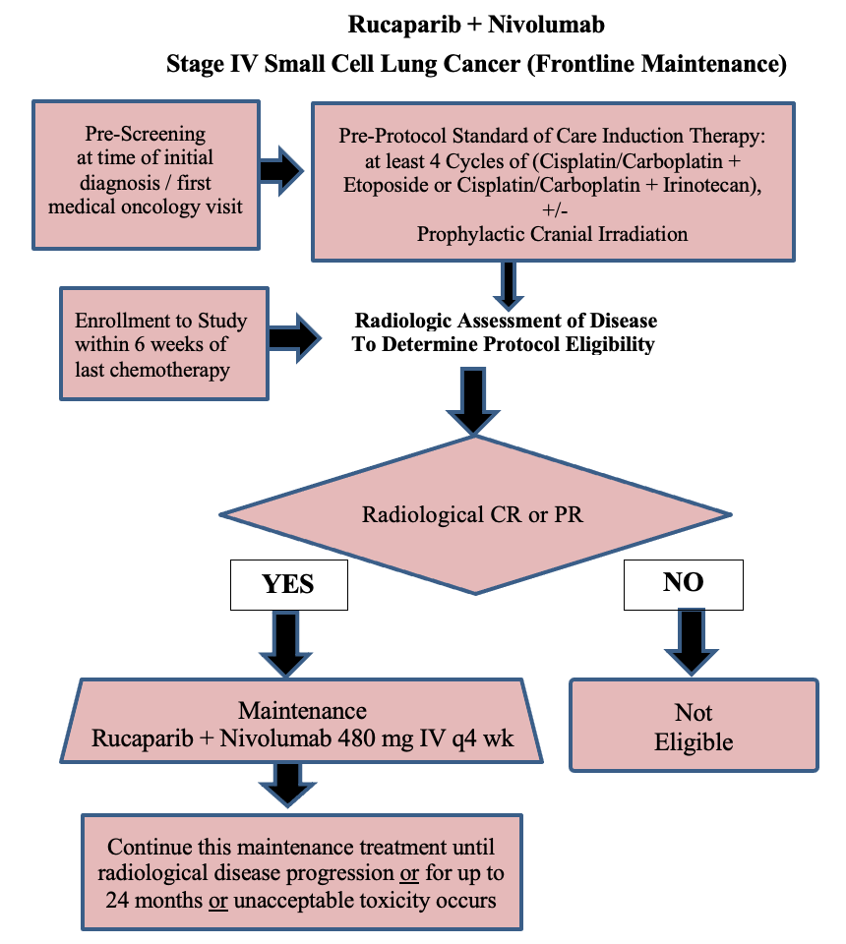
Study Design
  Single-arm, single center, phase II trial (NCT03958045)
  Platinum sensitive ES SCLC who received Nivolumab 480 mg IV every 4 weeks, and Rucaparib, 600 mg PO twice a day.
Notes:
Adjust font size and placement as needed to fit your content.

Slide 76
Results
A total of 42 patients were consented and 33 met eligibility criteria and were treated.
All patients received 4-6 cycles of frontline platinum doublet and had at least a partial response by RECIST at the time of enrollment.
The median PFS (mPFS) was 3 months from time of enrollment on frontline maintenance (post platinum doublet).
The mPFS was 11 months from cycle 1 of platinum doublet.
Overall, 89.8% patients were alive at 12 months and 54.4 % patients were alive at 24 months from the start of platinum doublet.
Currently 2 patients are on active treatment and other two have completed study treatment (24 month) and are on observation with stable disease.
Chauhan et. al. AACR 2023

Slide 77
A Phase 1/2 Trial of the Oncolytic Virus SVV-001 in Combination with Ipilimumab-Nivolumab in Patients with Poorly Differentiated Neuroendocrine Carcinomas and Well-Differentiated Neuroendocrine Tumors

Slide 78
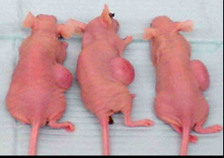
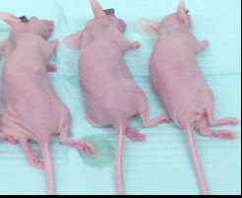
Virus Ablates – tumors in mice
Untreated mice
Single systemic administration resulted in 100 % complete tumor ablation
No overt toxicity
  Mice survived > 200 days until study termination
  No clinical signs-mice appeared normal & healthy
Treated mice

Slide 79
Rationale – Preclinical data
Seneca Therapeutics Study U2101
SVV-001 + Anti PD1 + Anti CTLA4
Study completed in January 2022
Pancreatic immune competent model

Slide 80
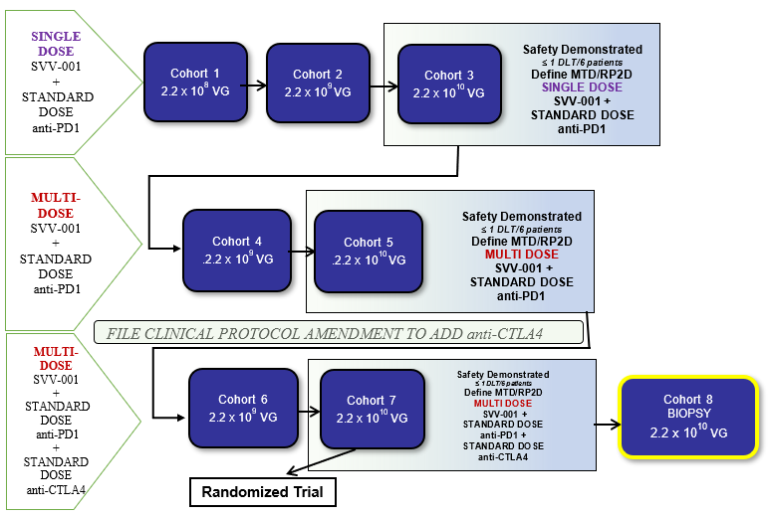
Phase 1 Schema
25 Sites with expertise in treating neuroendocrine cancer patients have been identified and are ready to enroll patients in Seneca’s Phase I clinical trial.
Protocol approved by FDA
Hallenback and Chauhan NANETS 2022

Slide 81
Innovative NEN trials in Pipeline at Sylvester
DLL-3 BITE ( SCLC and EP NEC)
SSTR Targeting PRRT (SCLC)
FAP targeting PRRT (Solid Tumors)

Slide 82
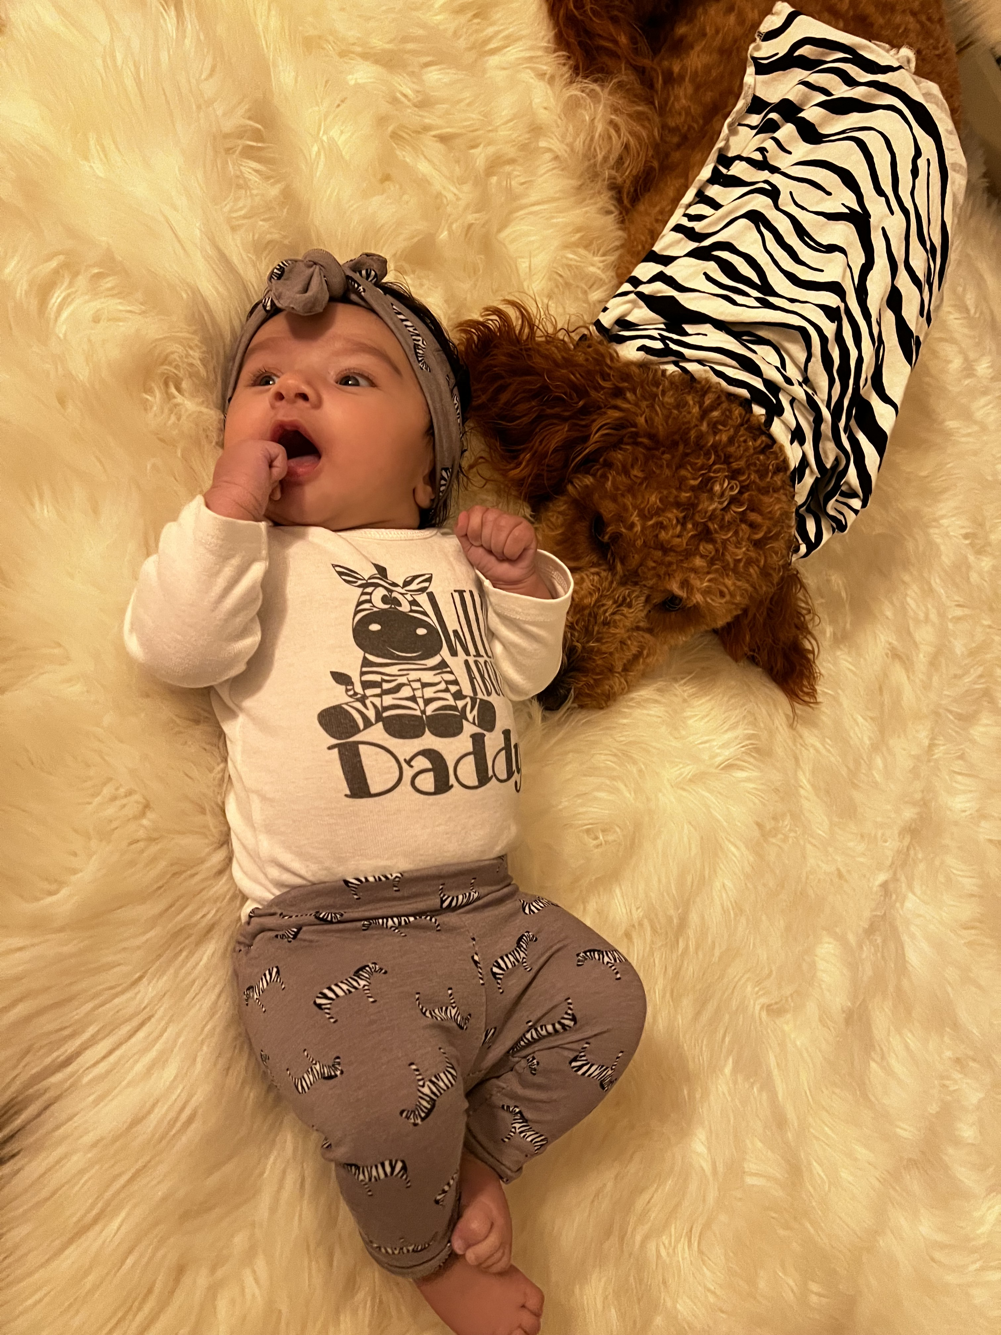
On to my next big Project…

Slide 83


Thank you
@AmanChauhanMD
axc3268@med.miami.edu

